Slide 1


Florida Springs and Aquifer Dilemma
John Moran Photo

Slide 2
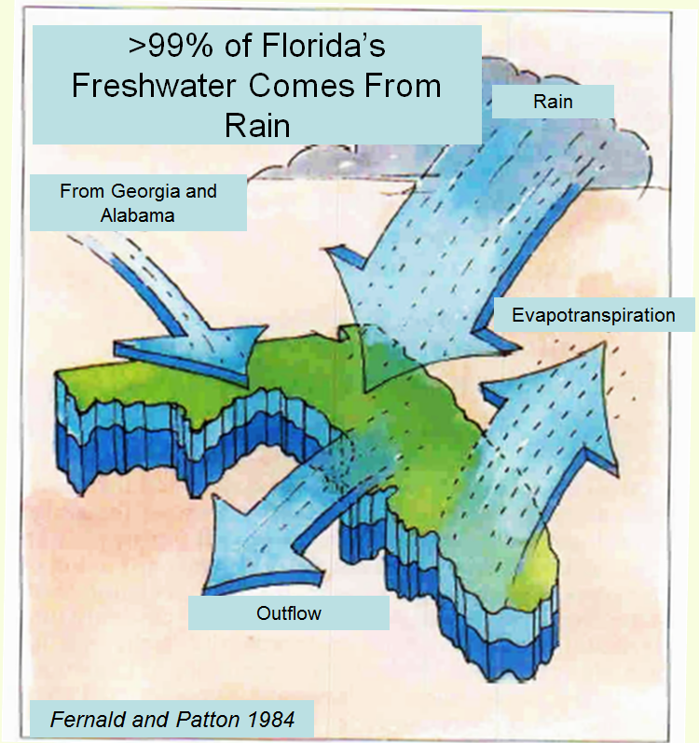

Water Budget
Average Annual Rainfall:
50 – 60” per year
Average Annual
Evapotranspiration (ET):
35-45” per year
Average Annual Recharge of Water into the Floridan Aquifer:
2 – 4” per year
Florida’s Freshwater Comes From Rain

Slide 3
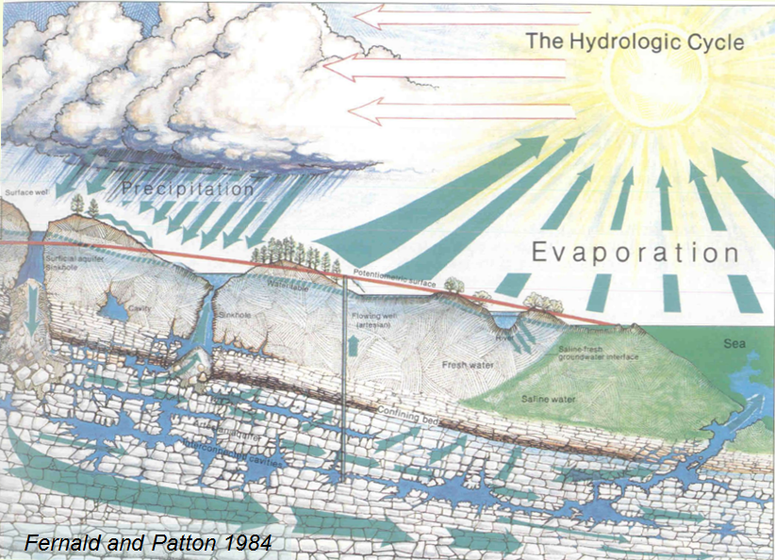
Floridan Aquifer Recharge = 6% of Rainfall or about 10.5 BGD to Florida’s springs
Precipitation
Evaporation
Groundwater Recharge
BGD = billion gallons per day; MGD = million gallons per day

Slide 4
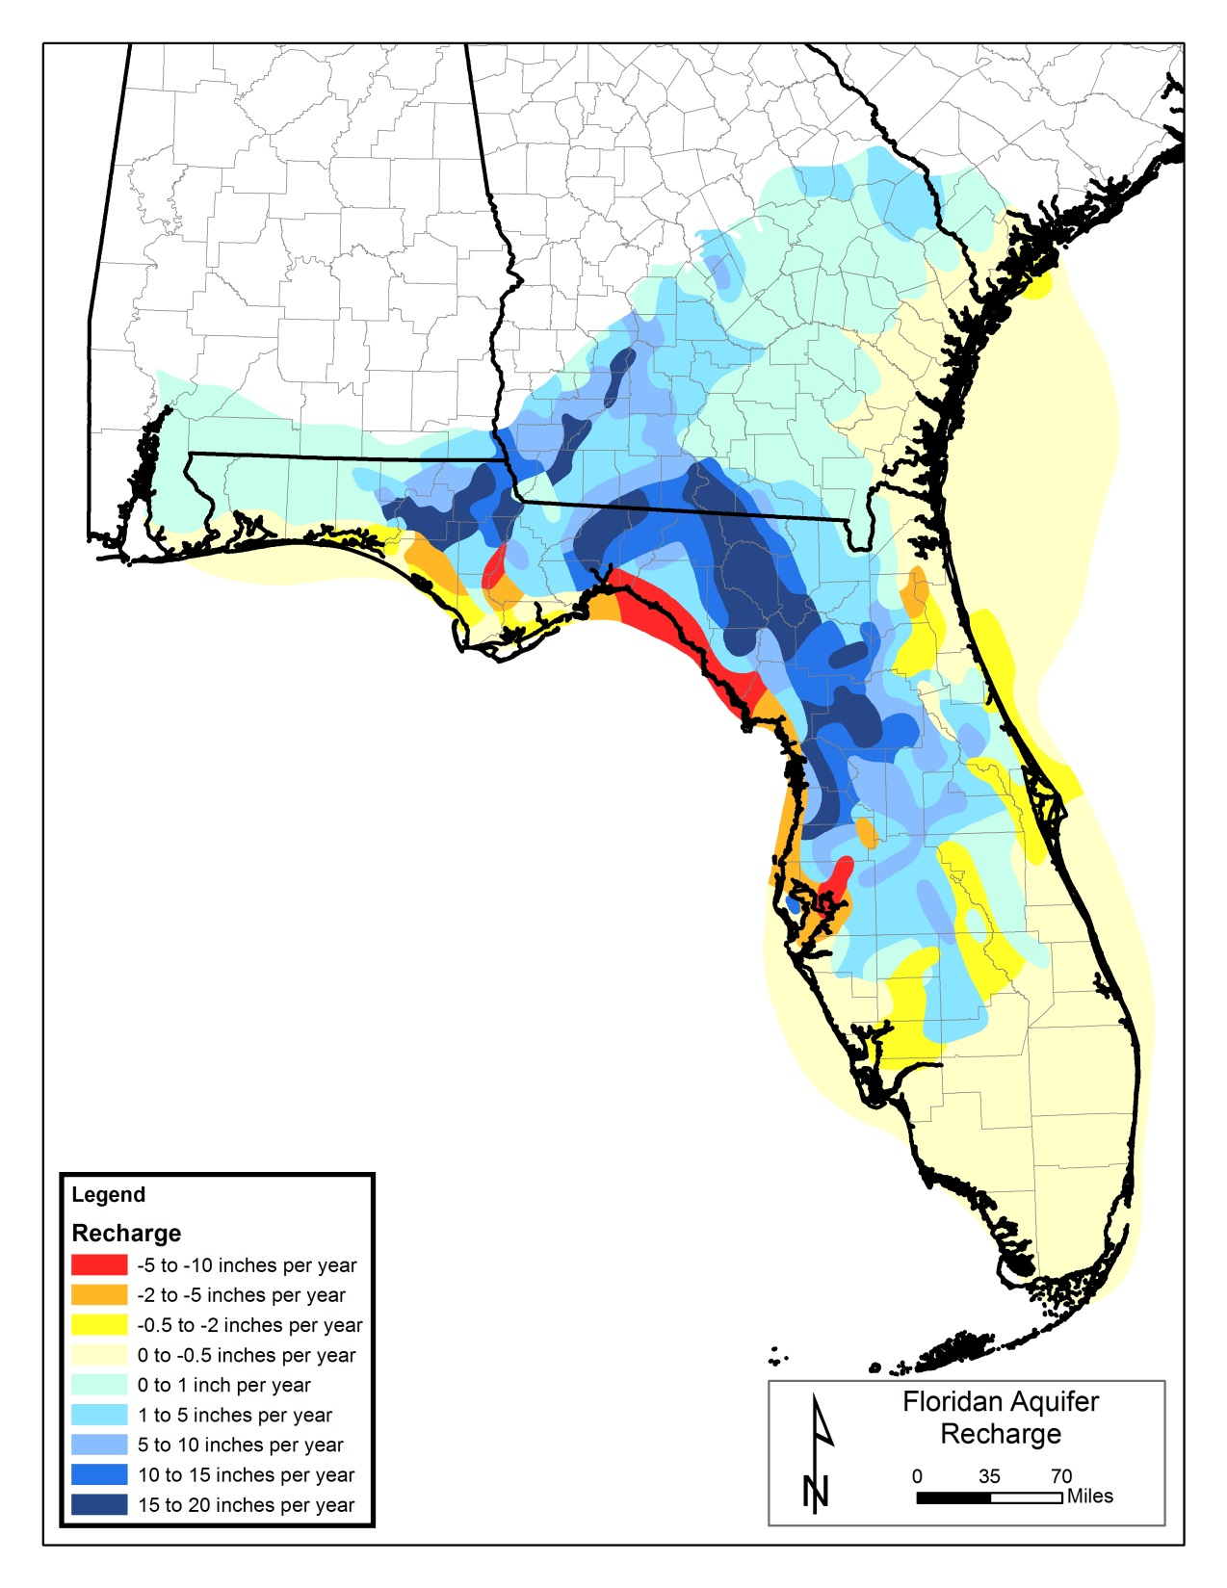
Average Recharge to the Floridan Aquifer
-10 to +20 inches per year
(USGS data)

Slide 5
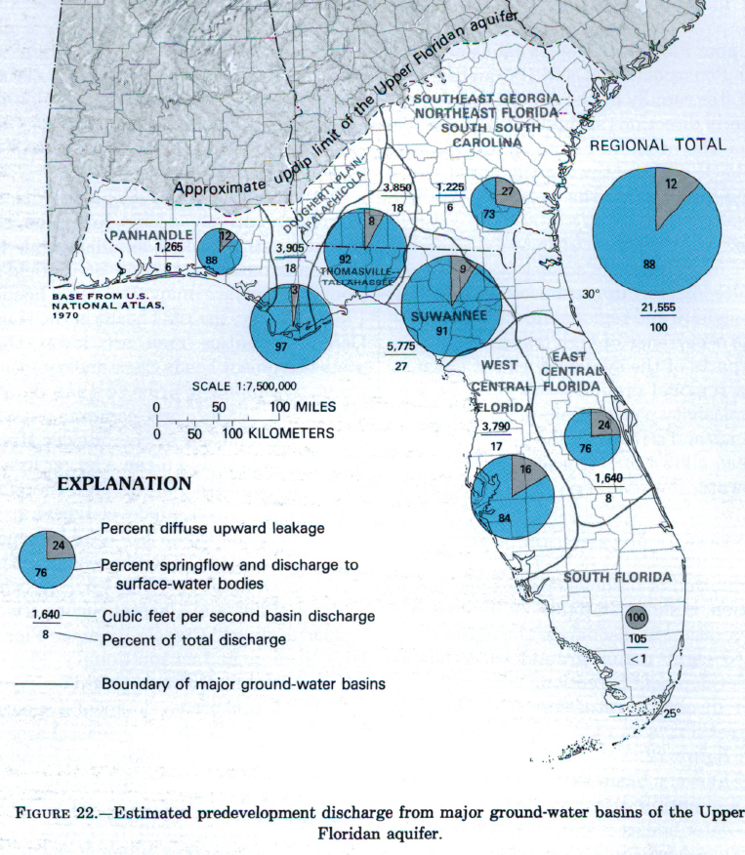
Floridan Aquifer Water Balance
Summary of Pre-development Conditions:
  Total groundwater discharge estimated as 14 BGD (88% springs and 12% diffuse flow)
  Regional spring flow 12 BGD
  Florida spring flow 10.5 BGD
Bush and Johnston 1988

Slide 6
Florida Spring Historic Flows and Declines by Water Management District (WMD)
(1930-2009)
NWF = Northwest Florida, SJR = St. Johns River, SR = Suwannee River, SWF = Southwest Florida. Data from Robert L. Knight and Ronald A. Clarke. 2016. Florida Springs—A Water-Budget Approach to Estimating Water Availability. Journal of Earth Science and Engineering 6 : 59-72.

Slide 7
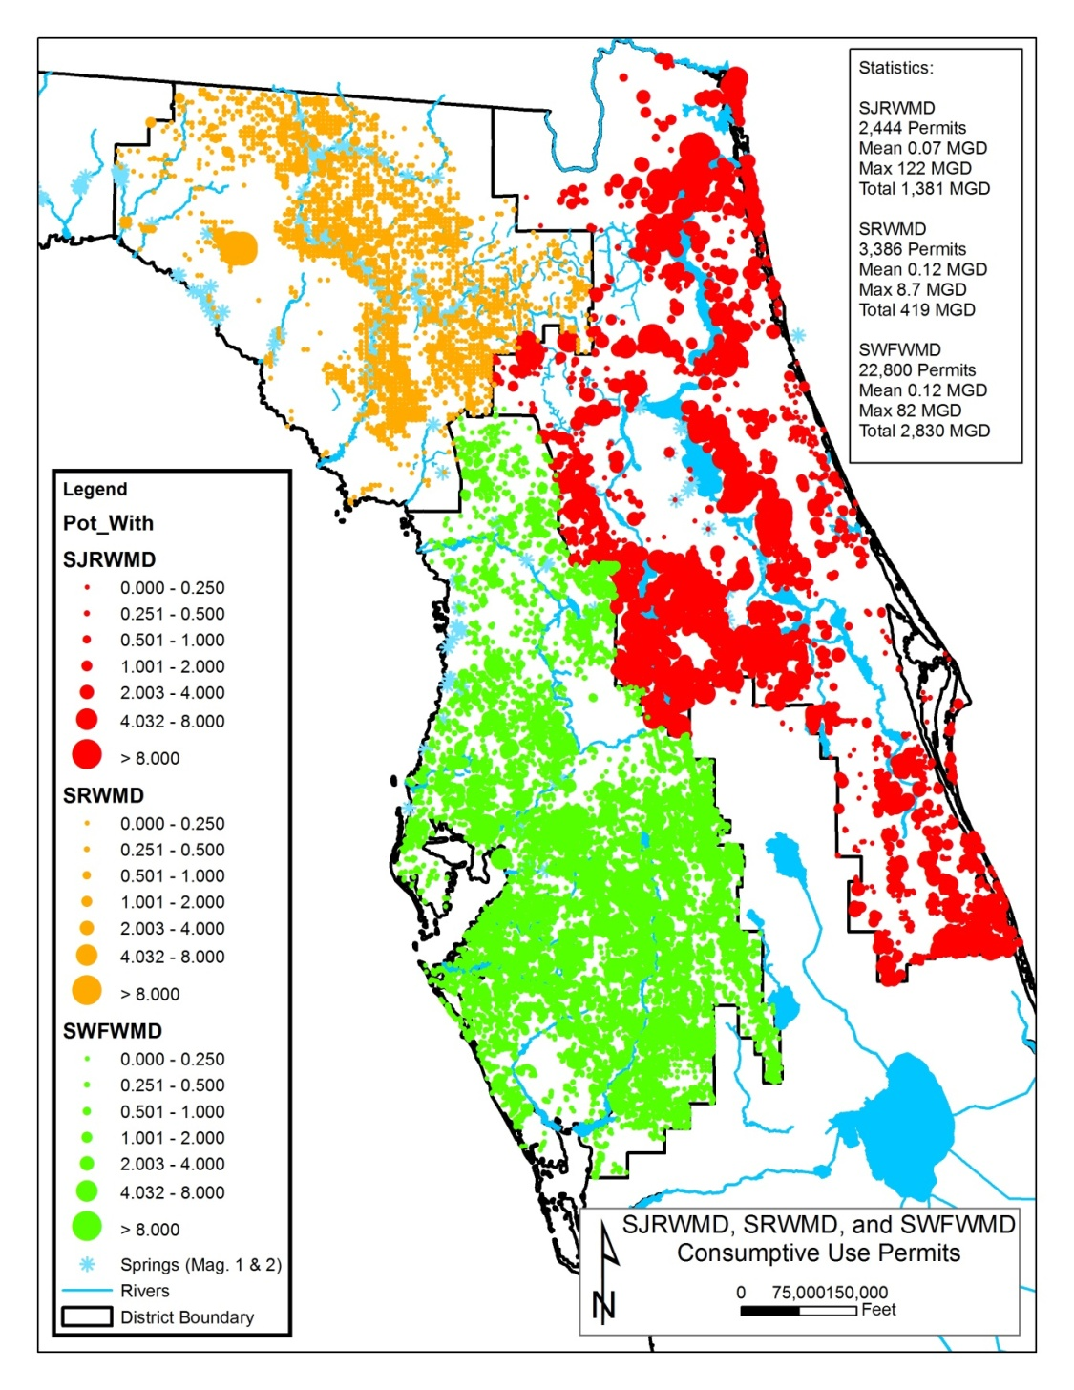

Florida’s Springs Dilemma
Regional Groundwater Permits - 2025
Suwannee River WMD 1,205 permits for up to 520 MGD from 4,550 wells
St. Johns River WMD 2,109 permits for up to 1,306 MGD from 9,171 wells
Southwest Florida WMD 1,279 permits for up to 980 MGD from 4,298 wells
Northwest Florida WMD has 413 permits for up to 316 MGD from 2,256 wells
WMD 2010 data

Slide 8
Florida Springs Region
Domestic Self-Supply and
Landscape Irrigation Wells
WMD | Domestic Wells | Landscape Wells | Totals
St. Johns | 98,345 | 78,975 | 177,320
Southwest | 61,419 | 24,065 | 85,484
Suwannee | 98,312 | 980 | 107,148
Totals | 258,076 | 104,020 | 369,952
WMD data

Slide 9
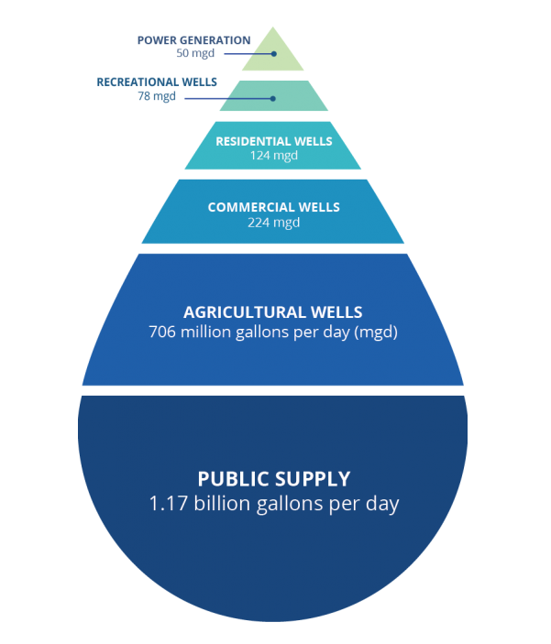
Withdrawals from the Floridan Aquifer in 2015
Total estimated groundwater use from the Floridan Aquifer in 2015 was 2.3 billion gallons per day
Public water supply accounted for 1.2 BGD
Agriculture accounted for 0.7 BGD (USGS 2015)

Slide 10
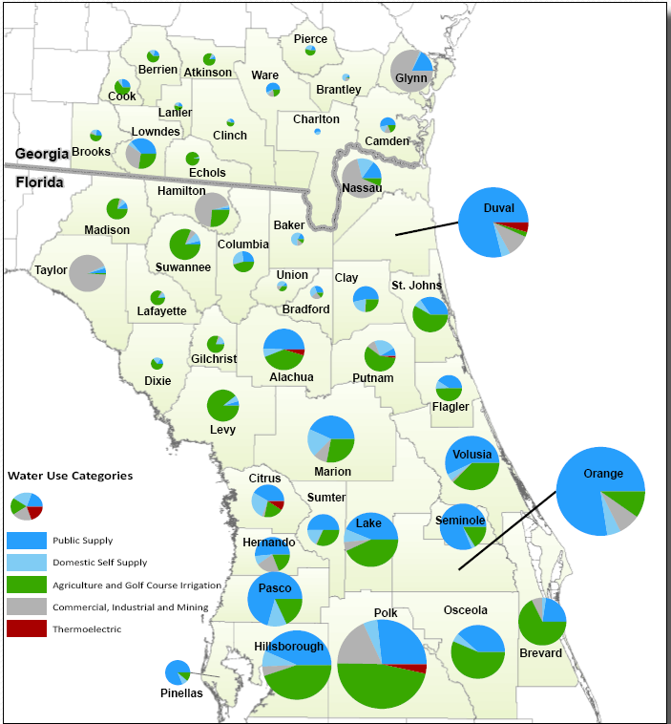
North Florida Groundwater Pumping (2010)
Pumping is concentrated in urban and industrial population centers:
Polk – 251 MGD
Orange – 249 MGD
Hillsborough – 151 MGD
Pasco – 94 MGD
Lake, Volusia, Osceola > 90 MGD each
2,622 MGD
USGS Data

Slide 11
Floridan Aquifer Levels are Falling
Decline in the water levels of the Floridan Aquifer:
Northeast FL: 20 to 60 ft
Marion County: 4 to 20 ft
Orlando area: 10 to 34 ft
Southwest FL: 20 to >60 ft
Silver Springs Groundwater Basin
Rainbow Springs Groundwater Basin
Florida Geological Survey

Slide 12
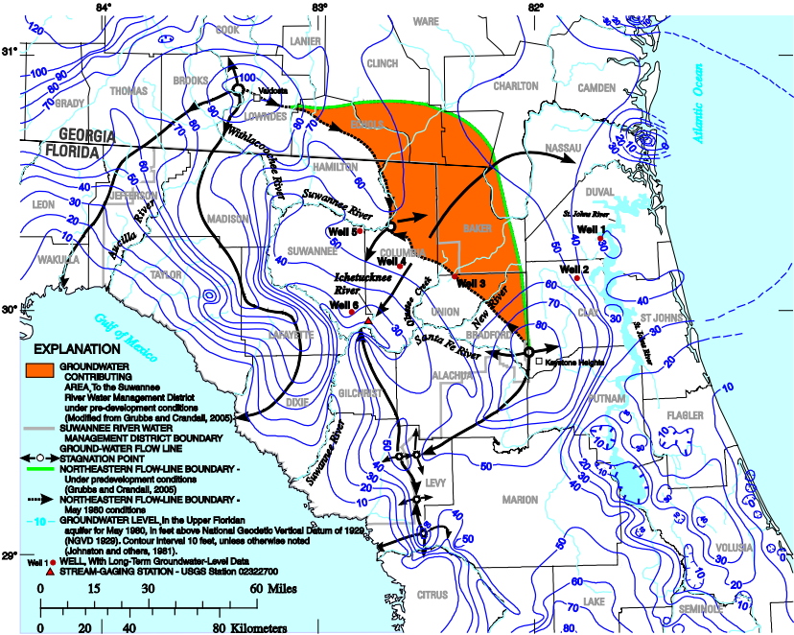
Potentiometric surface of the Upper Floridan aquifer during May 1980 showing: (1) key groundwater flow lines, (2) the northeastern flow-line boundary, and (3) the estimated area where groundwater flow has been diverted to the east away from the Suwannee, Ichetucknee, and Santa Fe Rivers (USGS 2011)
Williams et al. 2011

Slide 13
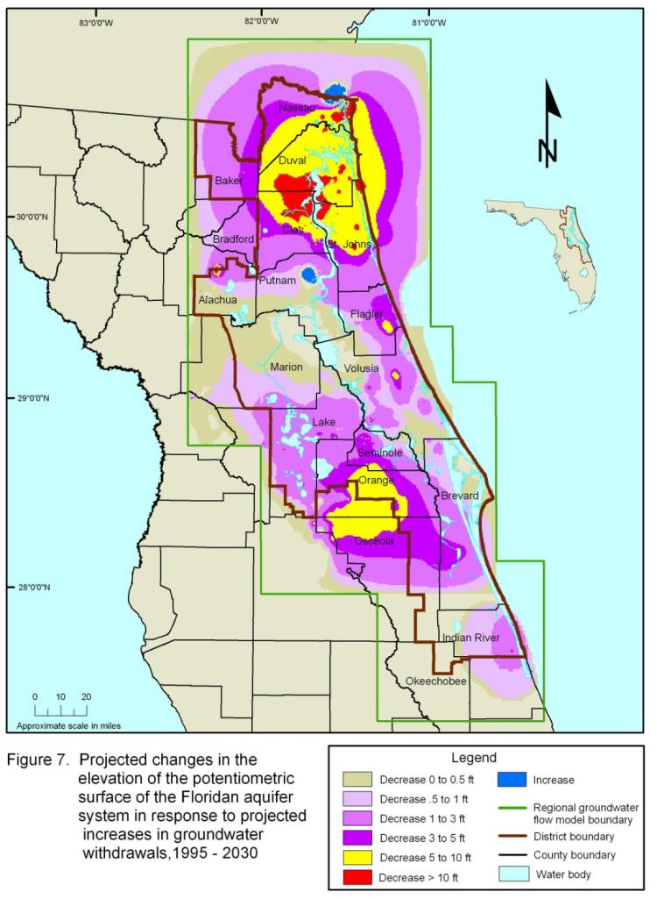
The Drawdown Problem is Projected to Get Worse
Projected changes in the elevation of the potentiometric surface of the Floridan aquifer system (1995-2030)
SJRWMD 2009
Notes:
The map on the screen shows projected changes in Floridan aquifer water levels from 1995-2030. These projected changes were generated using the flow models and water use projections.
Widespread water level declines are projected for the northeast Florida area. These declines are the result of numerous projected increases in groundwater withdrawals throughout the area. The declines create a cone of depression in the pressure of water, known as potentiometric pressure, in the Floridan aquifer. These declines are greatest in the red areas on the map, where declines are projected to be in excess of 10 feet.
Declines in the yellow areas are projected to be between 5 and 10 feet.
These declines decrease with distance away from the center of the cone of depression, in the areas that are shaded with various tones of purple on the map. The lightest tone represents the lowest projected decline.
The map clearly shows several cones of depression that have merged with one another throughout the area. This indicates that the cumulative impacts, not just impacts caused by individual users, need to be considered.
It is important to keep in mind that these declines represent water use changes in the St. Johns River Water Management District only. 2030 water use projections were not available for the Suwannee River Water Management District portion of the model domain. Because of this it is expected that these declines are under projected; that is, if projected increases in water use in the Suwannee River Water Management District were included, the declines would be more widespread and greater.

Slide 14
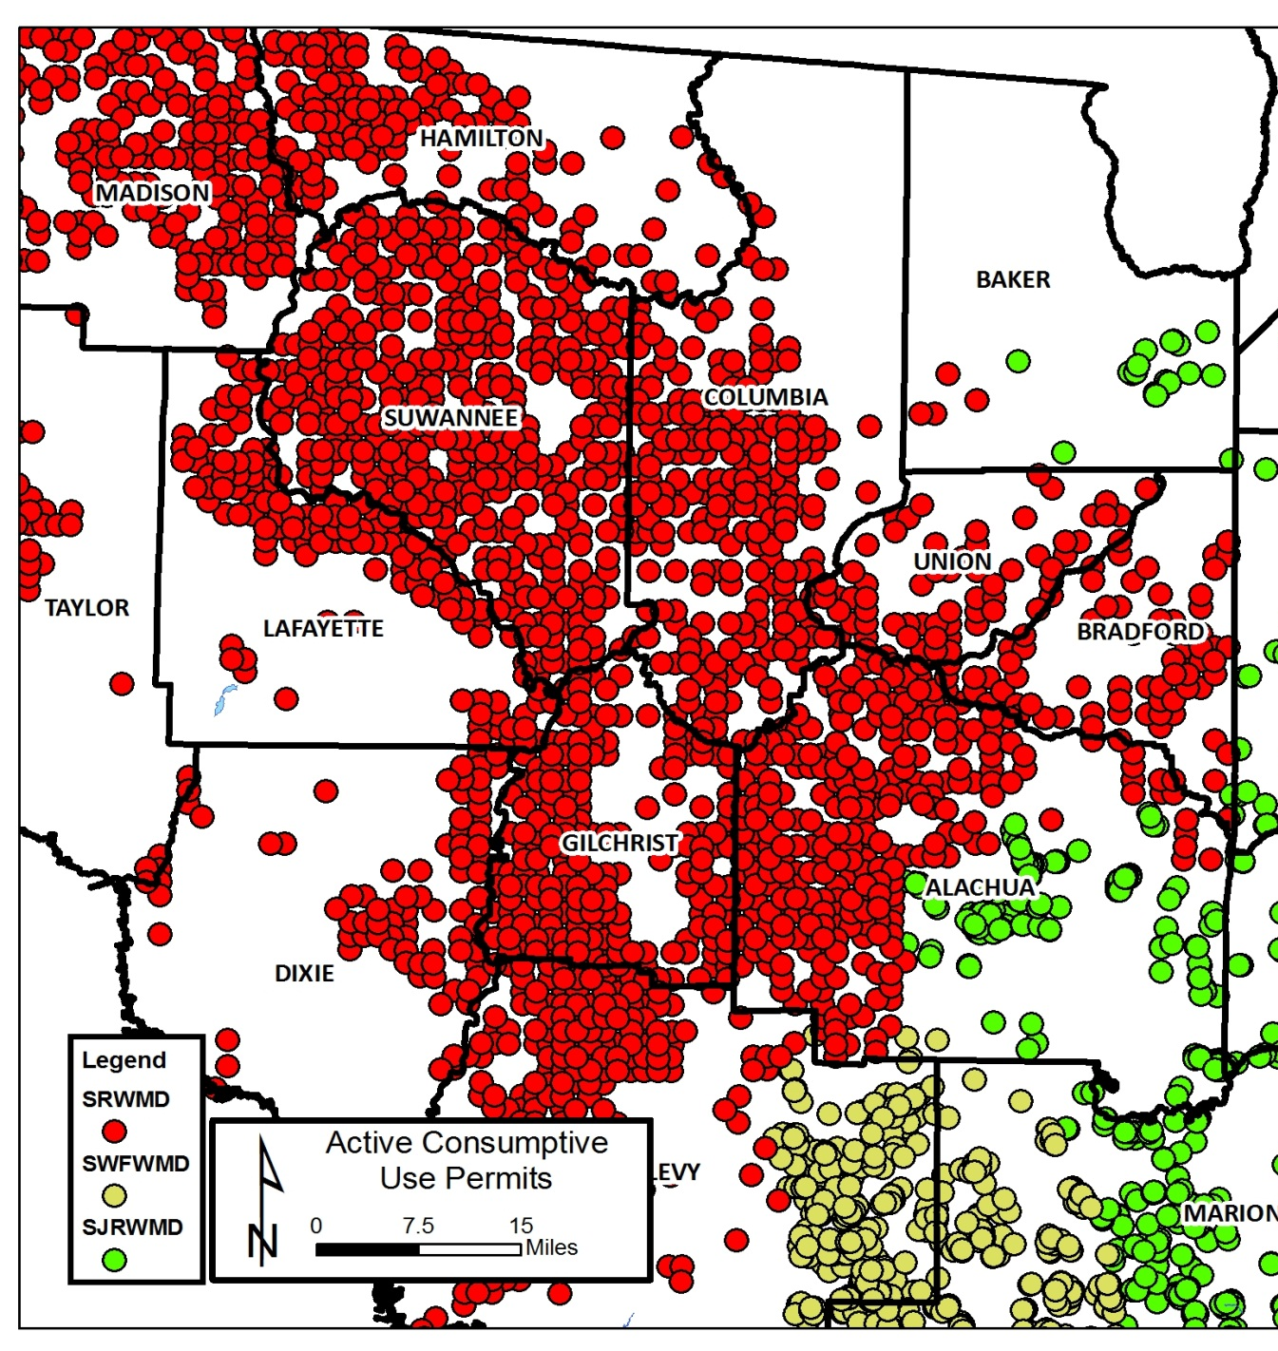
Florida’s Springs Dilemma
Suwannee River Water Management District
All wells in the Floridan Aquifer
  3,386 wells (419 MGD) in 2010
  4,550 large wells (520 MGD) in 2024
  Domestic and landscape irrigation wells 107,148 in 2025
Pumping
  2015 USGS est. pumping 223 MGD
Flow reduction in Suwannee River Basin
  -1,750 MGD in 2020 (Wilcox Gauge)
  Springs -48% (-2,296 MGD) by 2010

Slide 15
Florida’s Springs Dilemma
Suwannee River Water Management District
Non-agricultural groundwater permits

Slide 16
Florida’s Springs Dilemma
Suwannee River Water Management District
Largest groundwater permits

Slide 17
Florida’s Springs Dilemma
Suwannee River Water Management District
Largest agricultural groundwater permits

Slide 18
Florida’s Springs Dilemma
Suwannee River Water Management District
Largest non-agricultural groundwater users
(>500,000 gallons per day for 2019 – 2023)
Note: The Buckeye/Foley pulp and paper mill closed operations in 2023

Slide 19
Florida’s Springs Dilemma
Suwannee River Water Management District
Largest for-profit, non-ag corporations that benefitted from free groundwater (2019 – 2023)
Note: The Buckeye/Foley pulp and paper mill closed operations in 2023

Slide 20
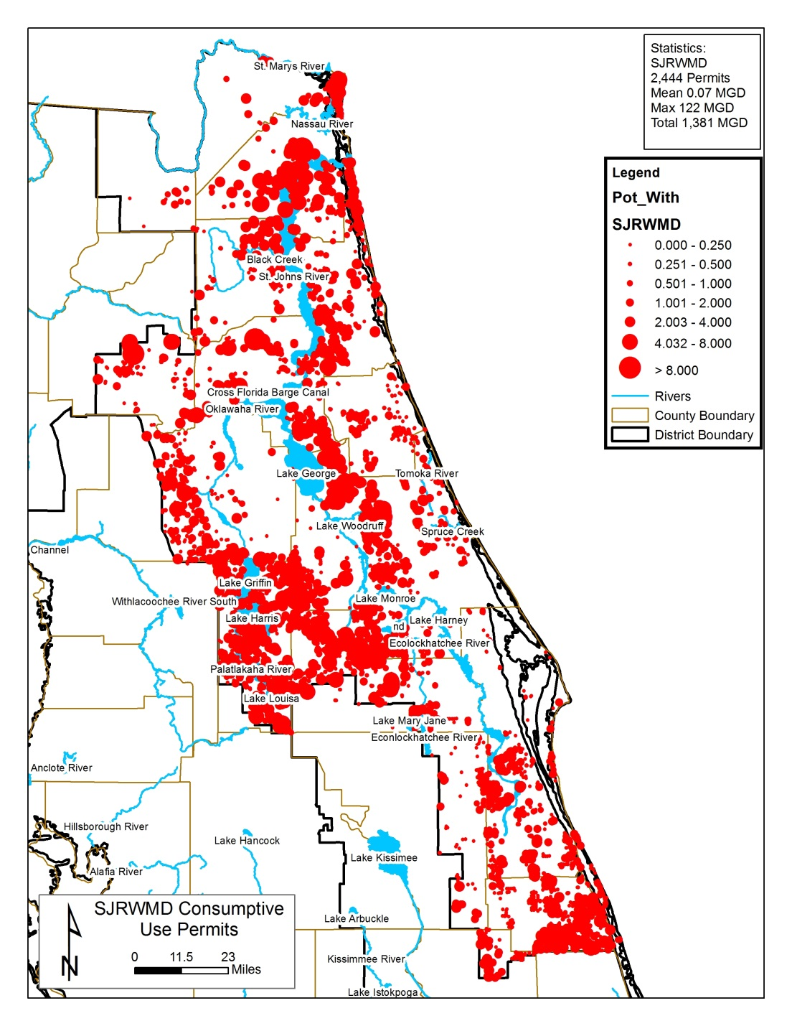
Florida’s Springs Dilemma
St. Johns River Water Management District
All wells in the Floridan Aquifer
  2,109 permits, 9,171 large wells (1,306 MGD) in 2025
  Domestic and landscape irrigation wells 177,320
2015 USGS est. total pumping 868 MGD
2020-2025 reported pumping permitted wells 780 MGD
Flow reduction in St. Johns River Basin 1950-2020
  Springs -26% (-255 MGD)
  River -22% (-1,128 MGD)

Slide 21
Florida’s Springs Dilemma
St. Johns River Water Management District
Largest groundwater users
(>6 MGD for 2020 – 2024)

Slide 22
Florida’s Springs Dilemma
St. Johns River Water Management District
Largest for-profit, non-agricultural corporations
benefiting from free groundwater

Slide 23
Florida’s Springs Dilemma
St. Johns River Water Management District
Largest agricultural groundwater users (2020-2024)

Slide 24
Florida’s Springs Dilemma
St. Johns River Water Management District
Largest agricultural groundwater permits

Slide 25
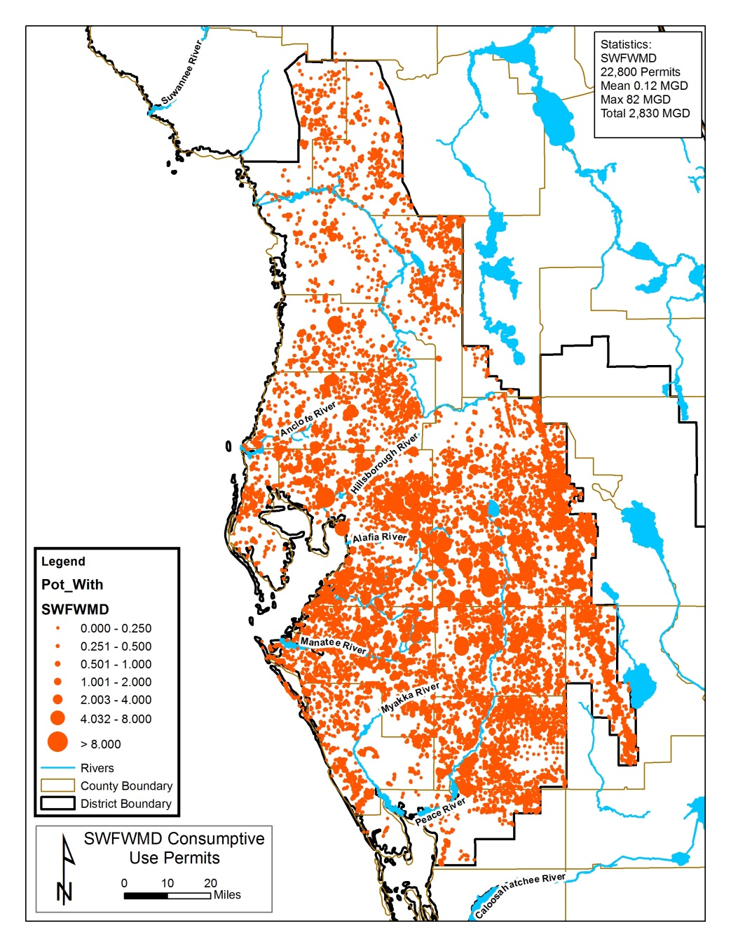
Florida’s Springs Dilemma
Southwest Florida Water Management District
All wells in the Floridan Aquifer
  4,298 permitted large wells (1,279 for 980 MGD) in 2025
  Domestic and landscape irrigation wells 85,484
Flow reduction in Nature Coast Basin
  Springs -18% (-379 MGD) by 2010
  2015 USGS est. total pumping 773 MGD
  2020-2025 reported pumping large wells 593 MGD

Slide 26
Florida’s Springs Dilemma
Southwest Florida Water Management District
Largest Groundwater Permits

Slide 27
Florida’s Springs Dilemma
Southwest Florida Water Management District
Largest Multiple Groundwater Permits – Mosaic Fertilizer

Slide 28
Florida’s Springs Dilemma
Southwest Florida Water Management District
Largest Multiple Groundwater Permits – Alico Groves

Slide 29
Florida’s Springs Dilemma
Southwest Florida Water Management District
Largest Multiple Groundwater Permits – Ben Hill Griffin, Inc.

Slide 30
Florida’s Springs Dilemma
Southwest Florida Water Management District
Largest Multiple Groundwater Permits – Astin Strawberry

Slide 31
Florida’s Springs Dilemma
Southwest Florida Water Management District
Largest groundwater users (2020-2025)

Slide 32
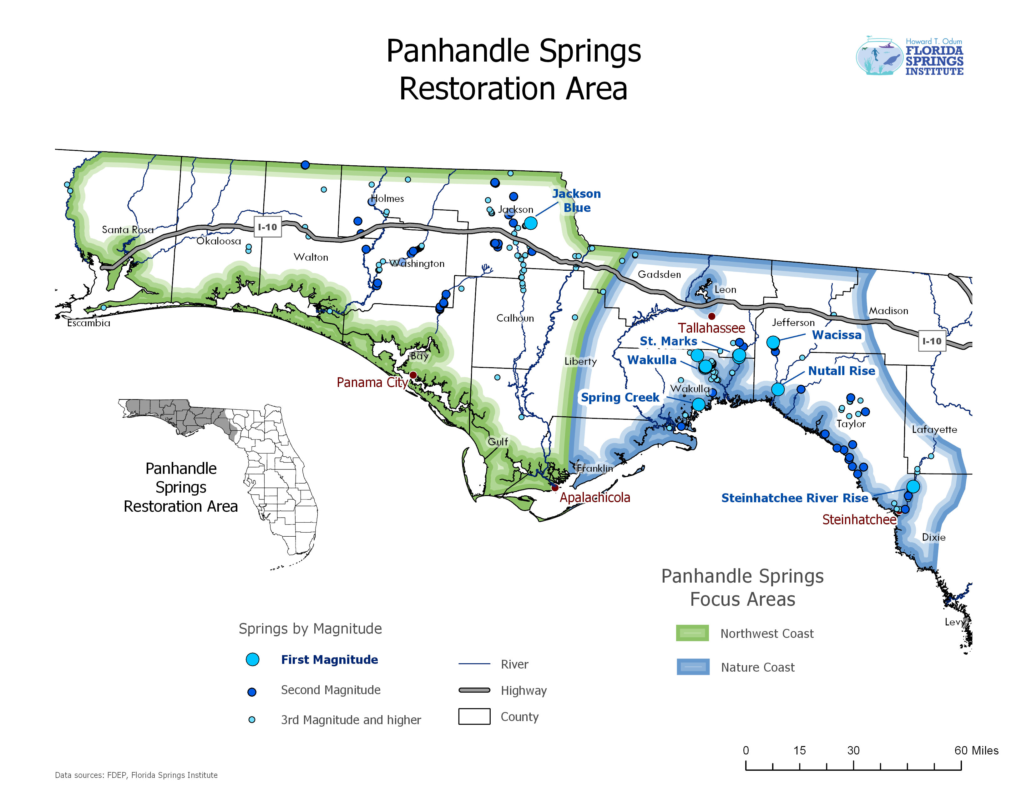
Florida’s Springs Dilemma
Northwest Florida Water Management District
Groundwater Wells
  Large wells 2,256, 413 permits, 316 MGD in 2025
2015 USGS est. pumping 241 MGD
2020-2025 reported pumping 192 MGD
Springs flow reduction in the Northwest Florida Basin by 2010
  -16% (-385 MGD)

Slide 33
Florida’s Springs Dilemma
Northwest Florida Water Management District
Largest Groundwater Permits

Slide 34
Florida’s Springs Dilemma
Northwest Florida Water Management District
Largest Groundwater Users
(>1,500,000 gallons per day for 2020 – 202)

