Slide 1
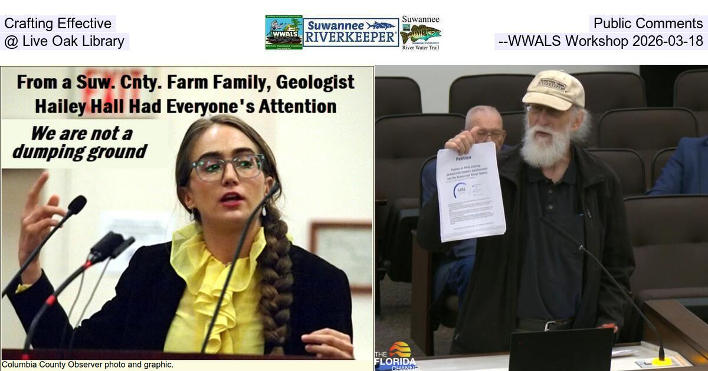
5-6:30 PM, Wednesday, March 18, 2026, 1848 Ohio Ave S, Live Oak, FL 32064

Slide 2



John S. Quarterman,
and Executive Director
Hailey Hall, Events Committee Member
WWALS Watershed Coalition, Inc. (WWALS)
a 501(c)(3) nonprofit, est. 2012,
for clean water
In the 10,000-square-mile Suwannee River Basin
in Georgia and Florida

Slide 3
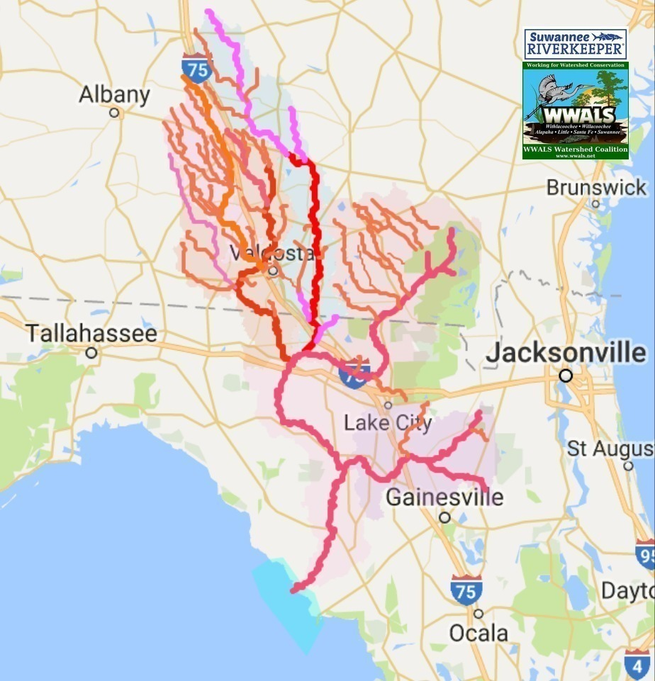
Suwannee River Basin and Estuary
More area than any of six states
Less population than any state

Slide 4
WWALS Vision: A healthy watershed with clean, swimmable, fishable, drinkable water.
WWALS Mission:
WWALS advocates for conservation and stewardship of the surface waters and groundwater of the Suwannee River Basin and Estuary, in south Georgia and north Florida, among them the Withlacoochee, Willacoochee, Alapaha, Little, Santa Fe, and Suwannee River watersheds, through education, awareness, environmental monitoring, and citizen activities.

Slide 5
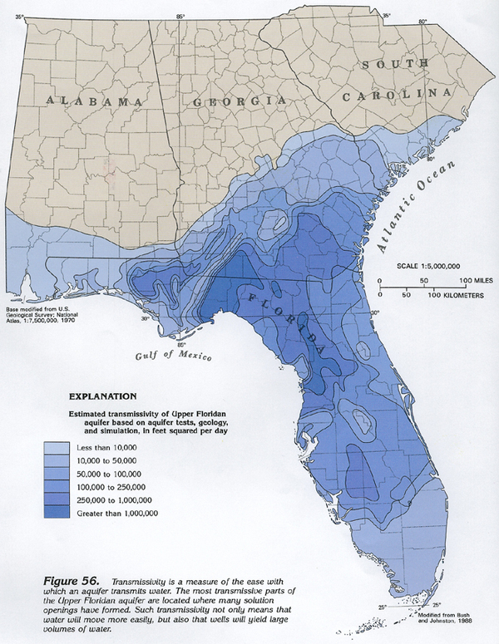
Floridan Aquifer
Basis of all our
drinking water, agriculture,
and industry

Slide 6
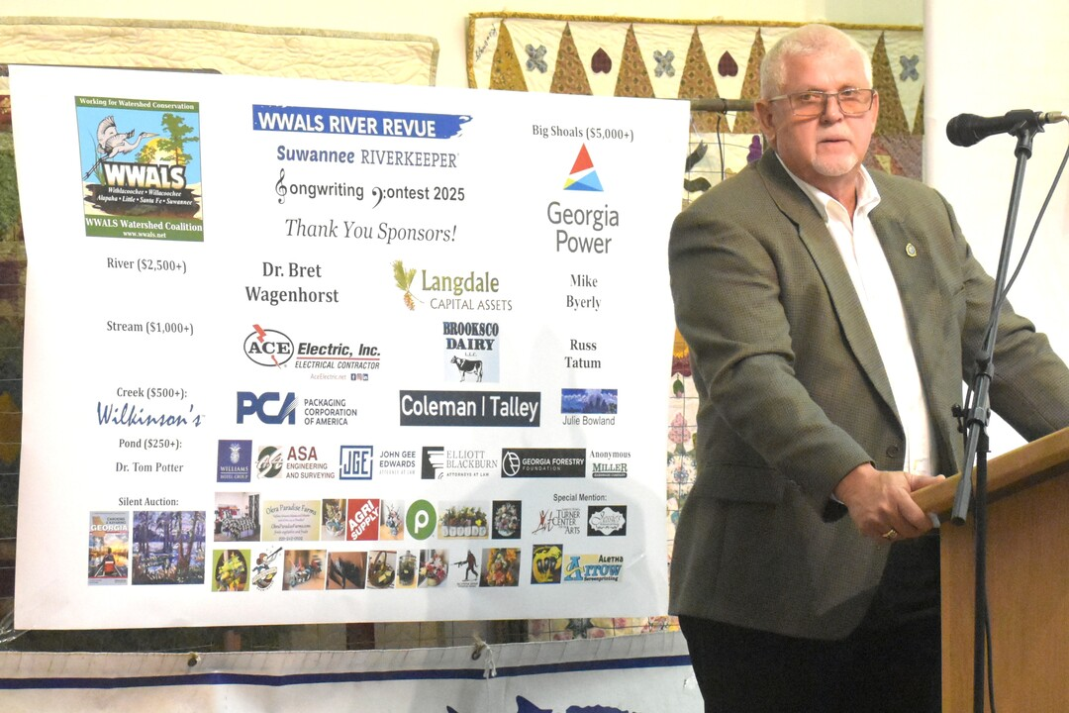
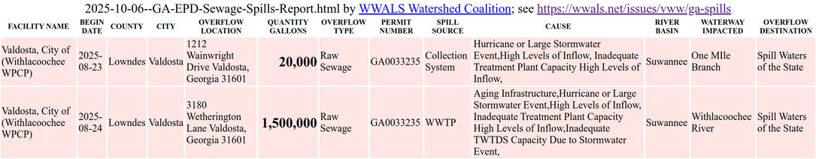
Rick Davis, chair of the River contamination Task Force
of the dozen downstream Florida counties
Spoke about the more than $160 million Valdosta has spent fixing its sewer system
He urged more water quality testing by Valdosta
WWALS thanks Lowndes County for no sewage spills in years.
Thanks to Valdosta for fewer spills that don’t last as long.
Thanks to GA-EPD for the daily Sewage Spills Report,
after WWALS got 30 GA & FL orgs to propose it in 2018.
Please fully fund Georgia Environmental Protection Division
Notes:
https://wwals.net/pictures/2018-10-31--ga-epd-spill-resolution/spills/2025-10-06--GA-EPD-Sewage-Spills-Report-basin.html

Slide 7
Stigma
Not downstream from Valdosta:
Suwannee River upstream from the Alapaha
Ichetucknee River
Santa Fe River
New River
Yet all 12 SRWMD counties
Are represented on the Task Force:
Sewage reputation affects them all.

Slide 8
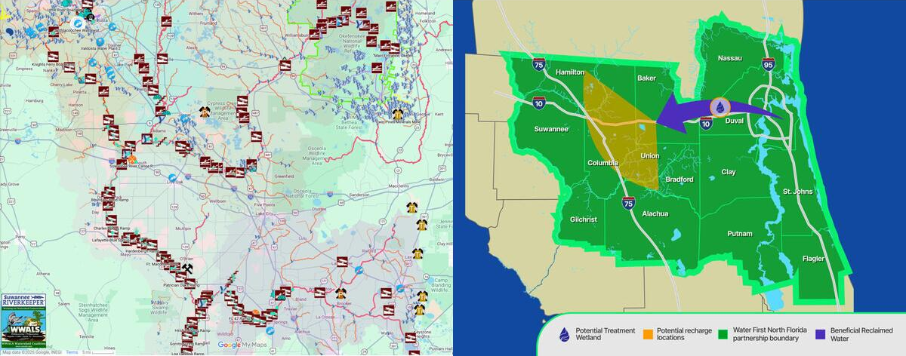
The Suwannee River Basin in Florida
is downstream from Valdosta’s wastewater spills
Should it also be downstream from Jacksonville?

Slide 9
What problem needs solving?
SRWMD and SJRWMD say
increasing water demand is the problem
What is projected to increase the most:
“Public Supply”

Slide 10
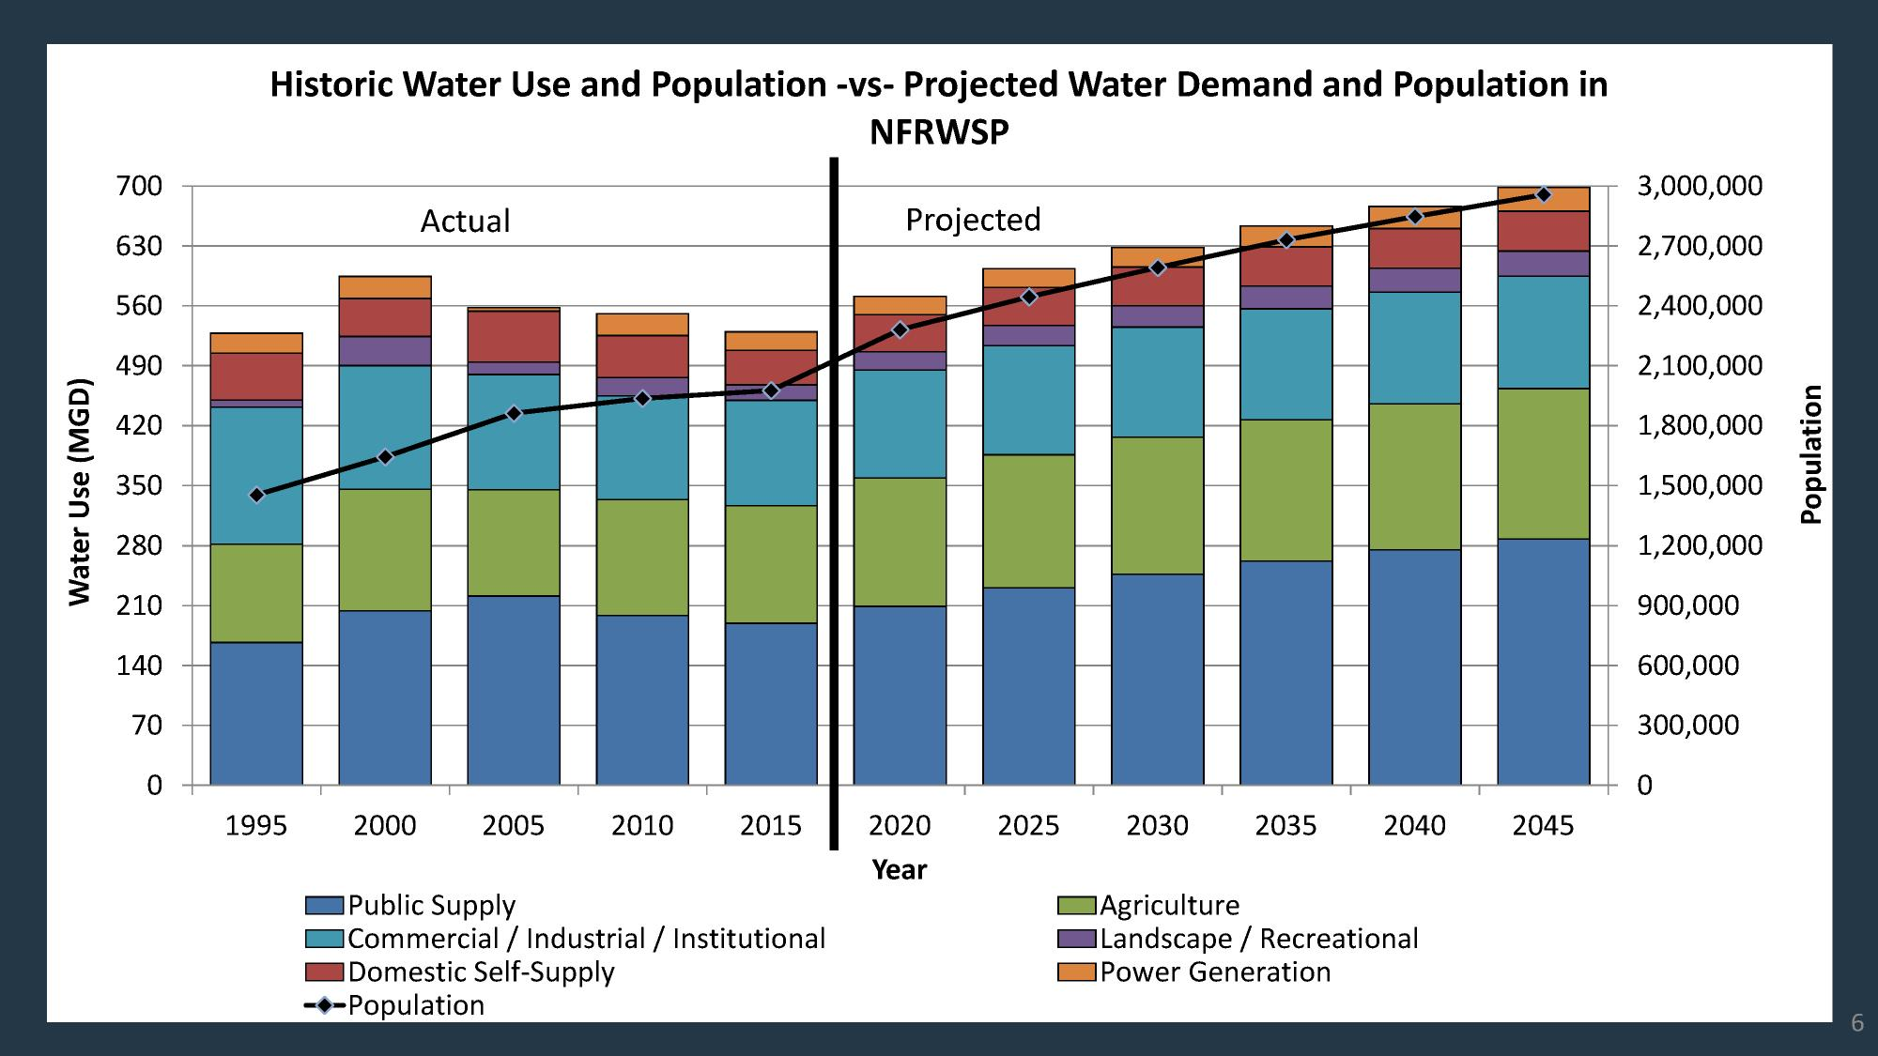
Notes:
Notice water use does not increase as fast as population.

Slide 11
Demand and population where?
The area of the
North Florida Regional Water Supply Partnership
(NFRWSP)
Much of the area of
Suwannee River Water Management District (SRWMD)
St Johns River Water Management District (SJRWMD)

Slide 12
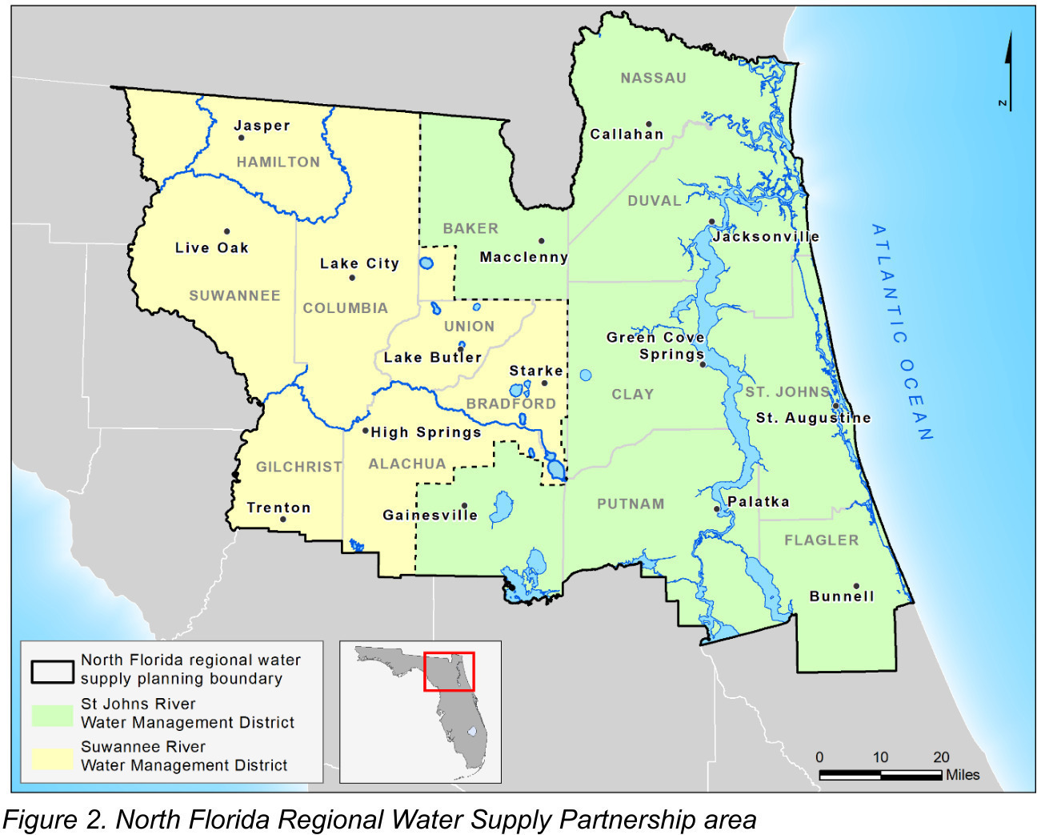

Slide 13
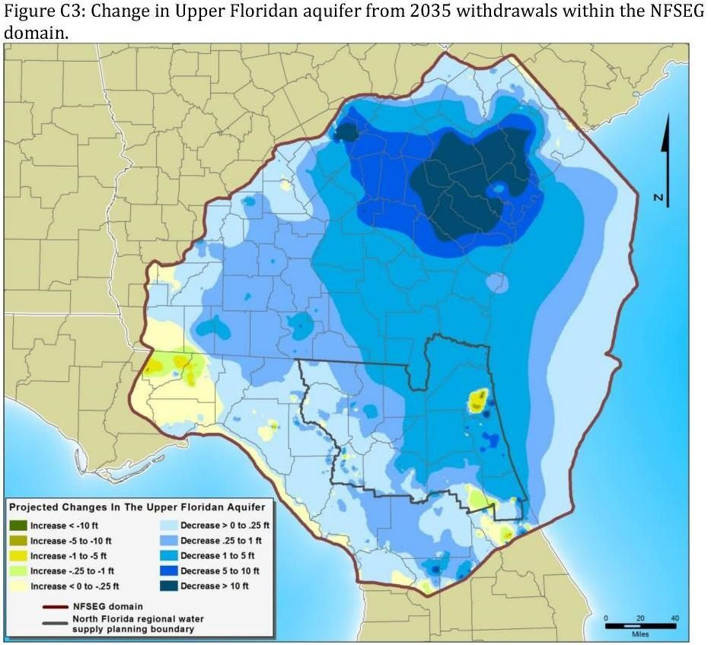
The island of higher aquifer water around JAX
Is because “Public Supply” pumping
Draws water from everywhere else

Slide 14
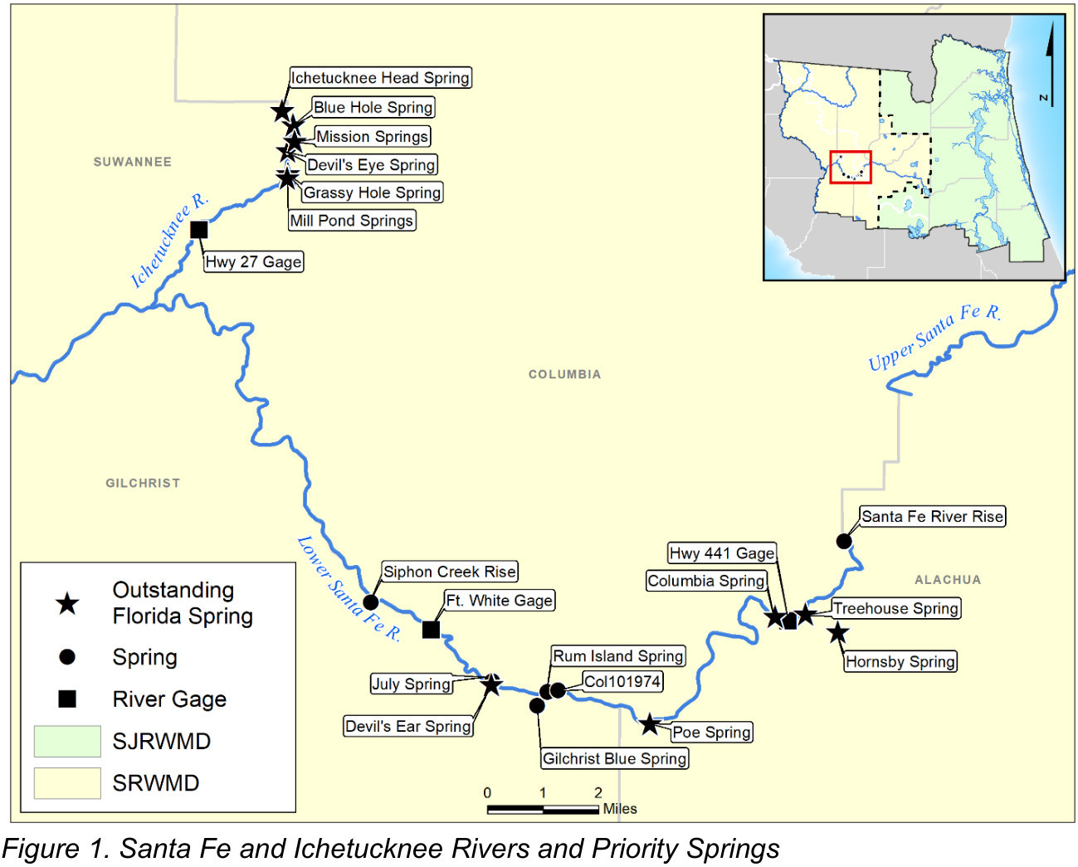
SRWMD and SJRWMD want to fix:
Lower
levels and
flows

Slide 15
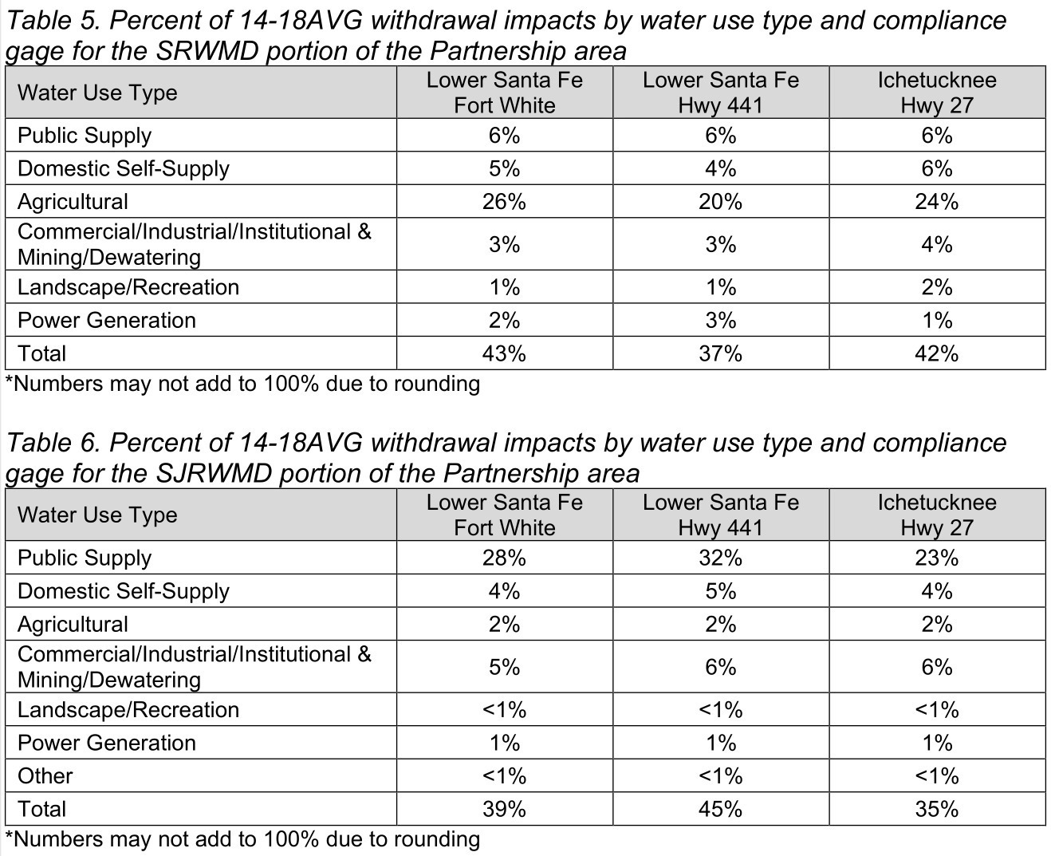
Agriculture uses most SRWMD water
But Public Supply uses most SJRWMD water

Slide 16
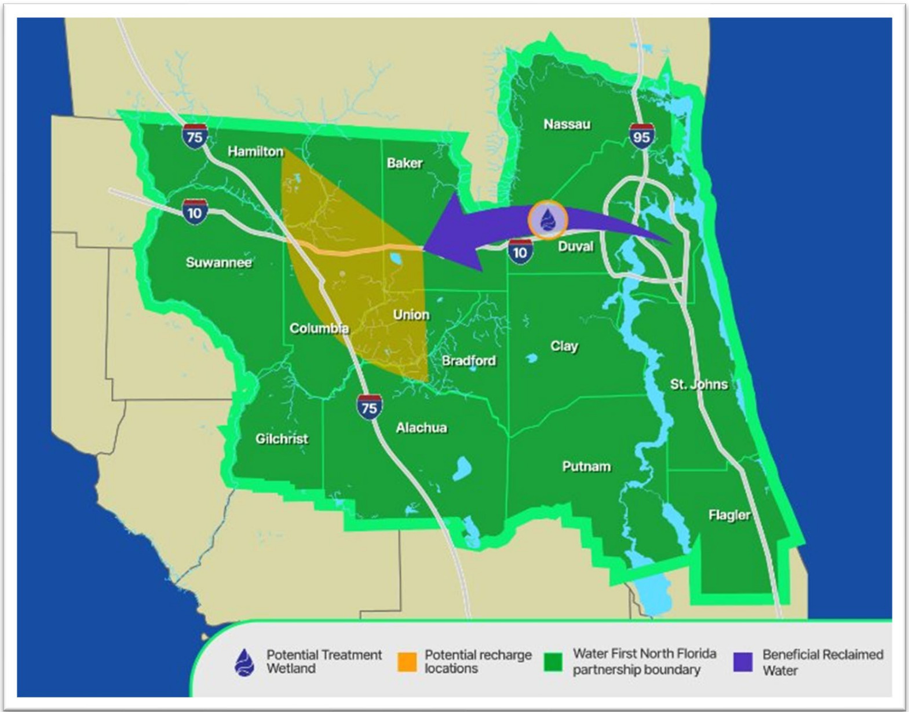
Why is this a solution?
(Treated JAX wastewater piped into wetlands in the Suwannee Basin)

Slide 17
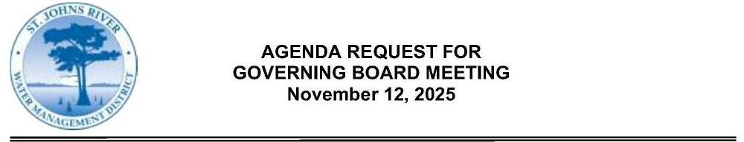
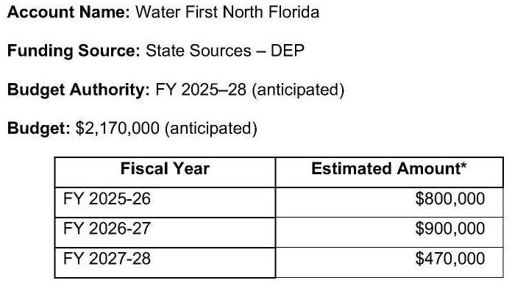
Why is SJRWMD hiring
to fix SRWMD levels & flows?

Slide 18
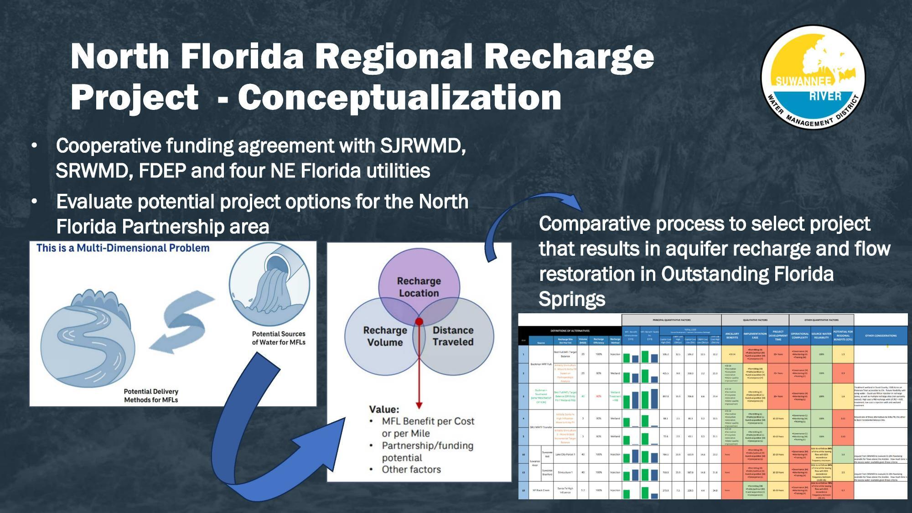
Slides from a July 8, 2025, staff presentation to SRWMD Board

Slide 19
Project Cost: $1 Billion
Who Pays?
Which four NE Florida utilities?
How much from each?
How much will customer rates rise?
How much from
SRWMD, SJRWMD, FDEP?
How much will taxes rise?

Slide 20
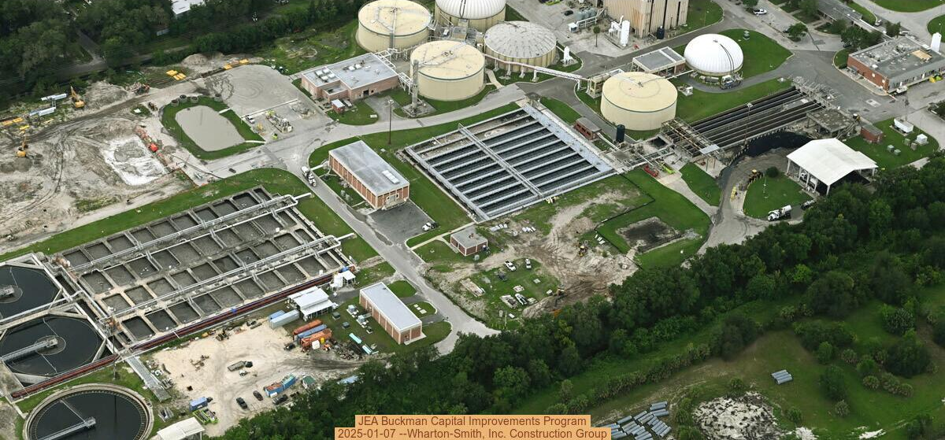
JEA approved $400 million for WFNF 2025-11-19

Slide 21
“According to JEA, minimum flows and water levels stipulate
how much water can be drawn from certain sources to avoid environmental damage from groundwater pumping. Because the Lower Santa Fe and Ichetucknee Rivers have not met those MFLs, the region has created Water First as its solution.”
–Marcela Camargo, new4jax.com, November 19, 2025
Who is this “the region”?
Floridians, do you remember voting for this project?
Do you remember any candidate saying they were for this project?
So who is this “the region” who created WFNF?

Slide 22
“JEA said the project will use high-quality reclaimed water
and further treat it through a wetland filtration system
before recharging it to the Floridan Aquifer.”
Why should the Suwannee Basin provide wetlands
for “further treatment” of Jacksonville wastewater?
What’s in it for JEA?
FL 2021 Senate Bill 64: into Florida Statutes 403.064 and 403.892
eliminating nonbeneficial surface water discharge within a specified timeframe: by 2032.
Then JEA can’t send treated wastewater into St. Johns River.

Slide 23
FL SB 64
“providing for the applicability of specified reclaimed water aquifer storage and recovery well requirements” was JEA’s first choice.
But: Florida Statutes 403.064 Section 17 (a)1.e. “The discharge provides
direct ecological or public water supply benefits,
such as rehydrating wetlands
or implementing the requirements
of minimum flows and minimum water levels
or recovery or prevention strategies for a waterbody.”

Slide 24
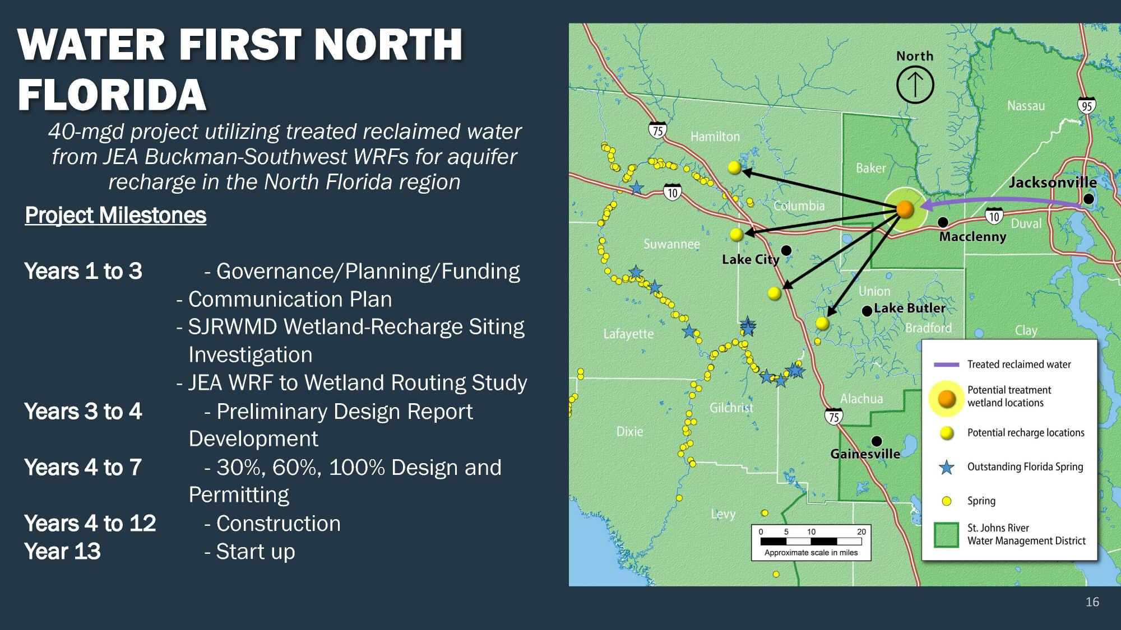

Slide 25
Route of this 60-mile-plus pipeline or pipelines?
Eminent domain?
Land values nearby?
Risks to drinking water wells?
Risks to agriculture?
Risks to industry?
Risks to recreation in springs and rivers?
Tourism is Florida’s biggest industry

Slide 26
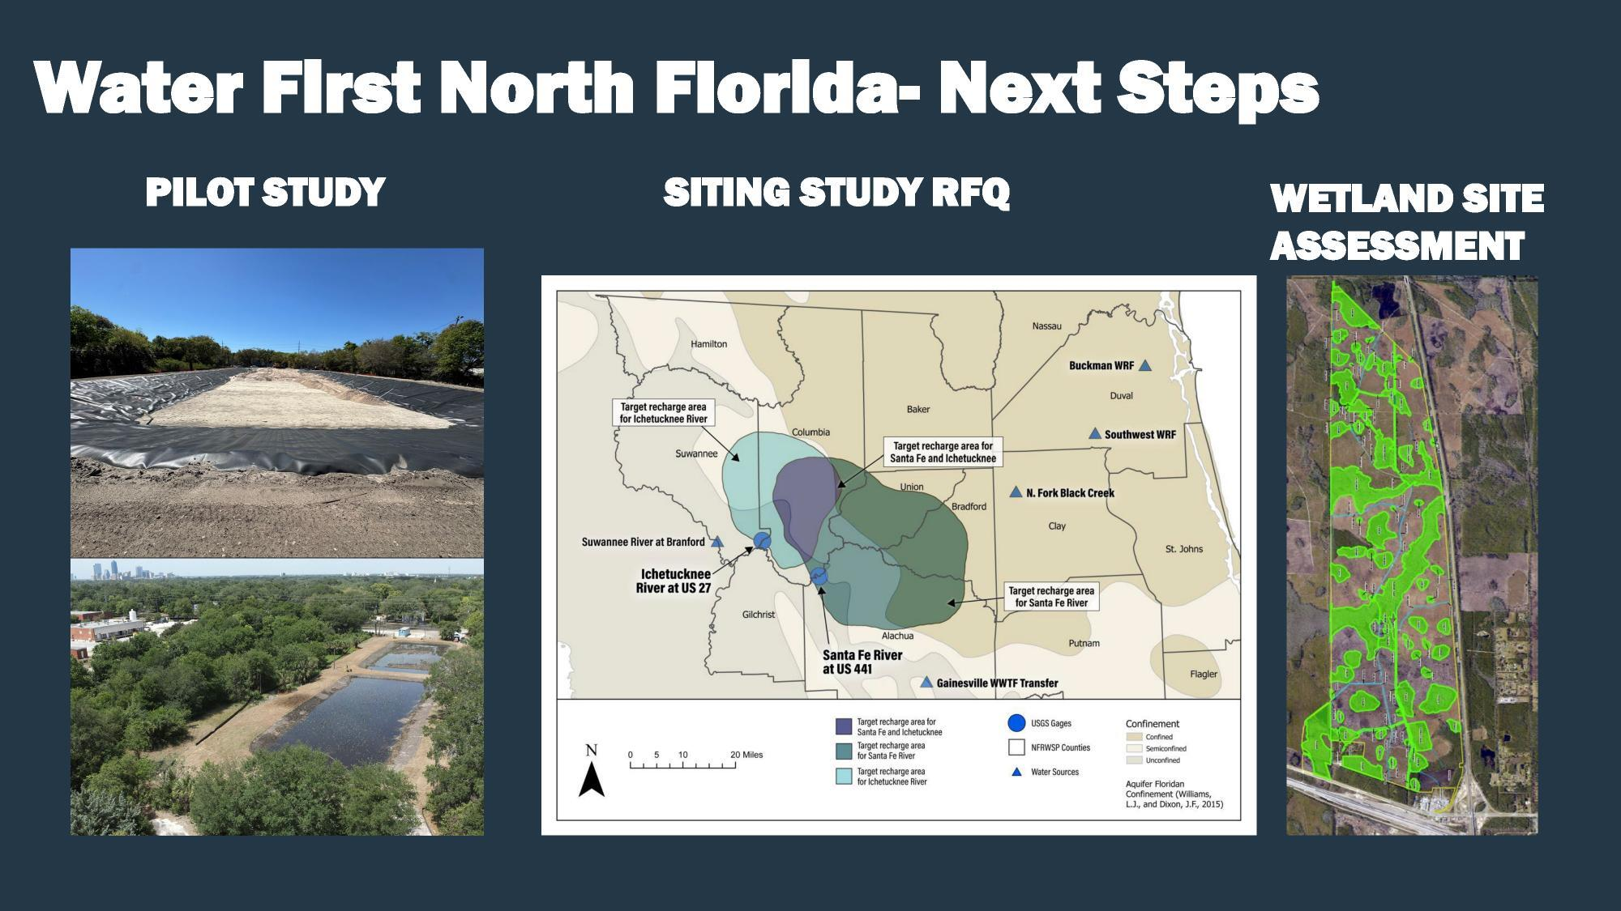

Slide 27
Why is SRWMD a junior non-voting partner along with JEA, GRU, Clay Utilities, and St. Johns Co. Utilities?
Where is the evidence that the source wastewater plant would remove PFAS forever chemicals, drugs, and artificial sweeteners?
Why should we believe that JEA’s Buckman wastewater plant will never fail and send untreated wastewater through the pipe,
despite being bigger than Valdosta’s wastewater system, which has repeatedly failed?

Slide 28
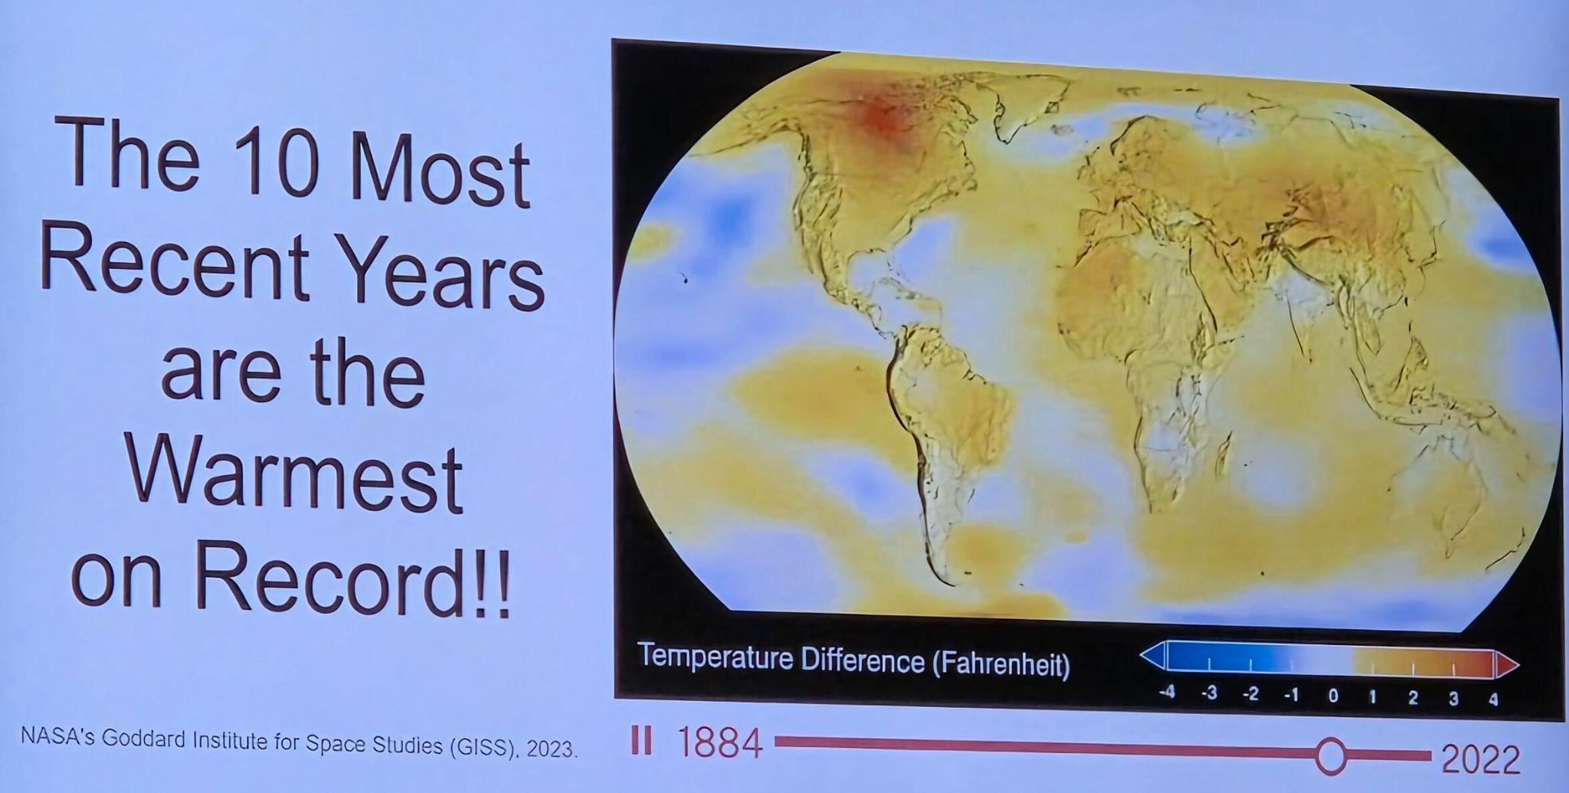
Slide by UFL researchers presented at SRWMD Workshop 2025-12-09

Slide 29
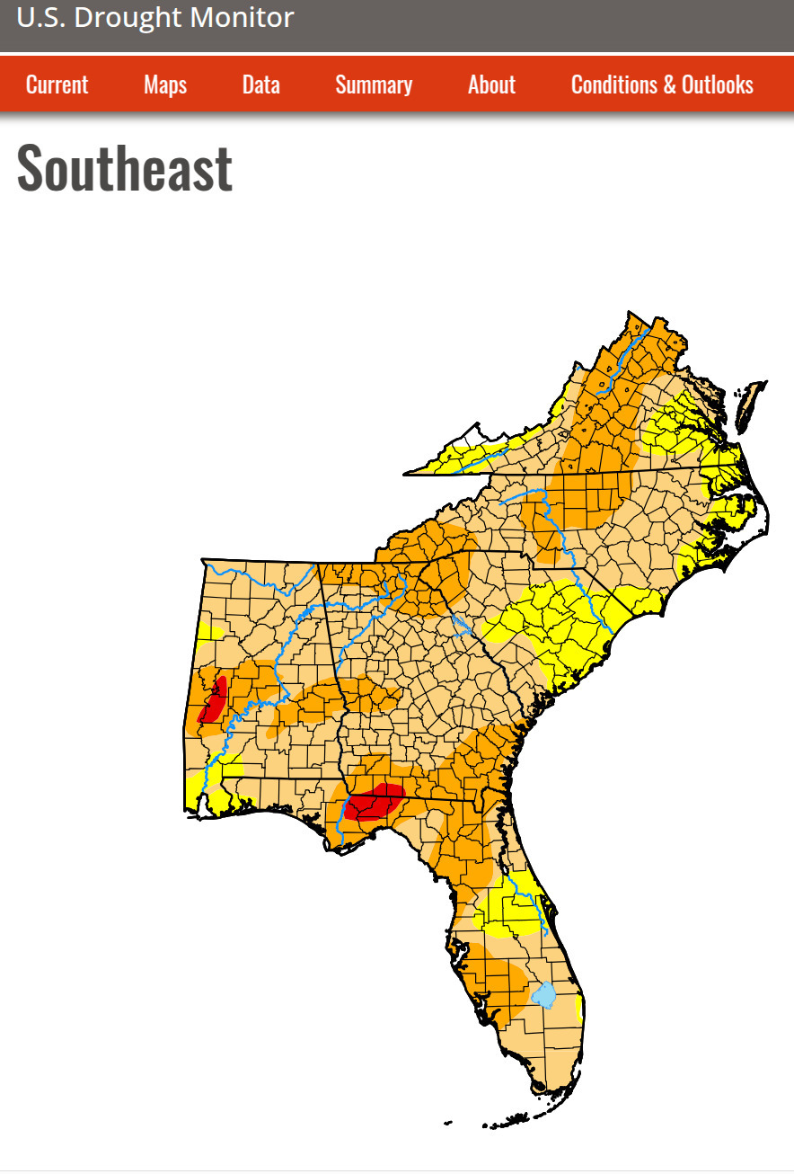
Solutions without massive infrastructure:
Limiting withdrawals
WMD permit standard conditions can require withdrawal limits, as in Phase II, III, IV Water Shortage
In November 2025, a SRWMD Board member asked for preparation for dryer and hotter
Eventually: limit permits issued

Slide 30
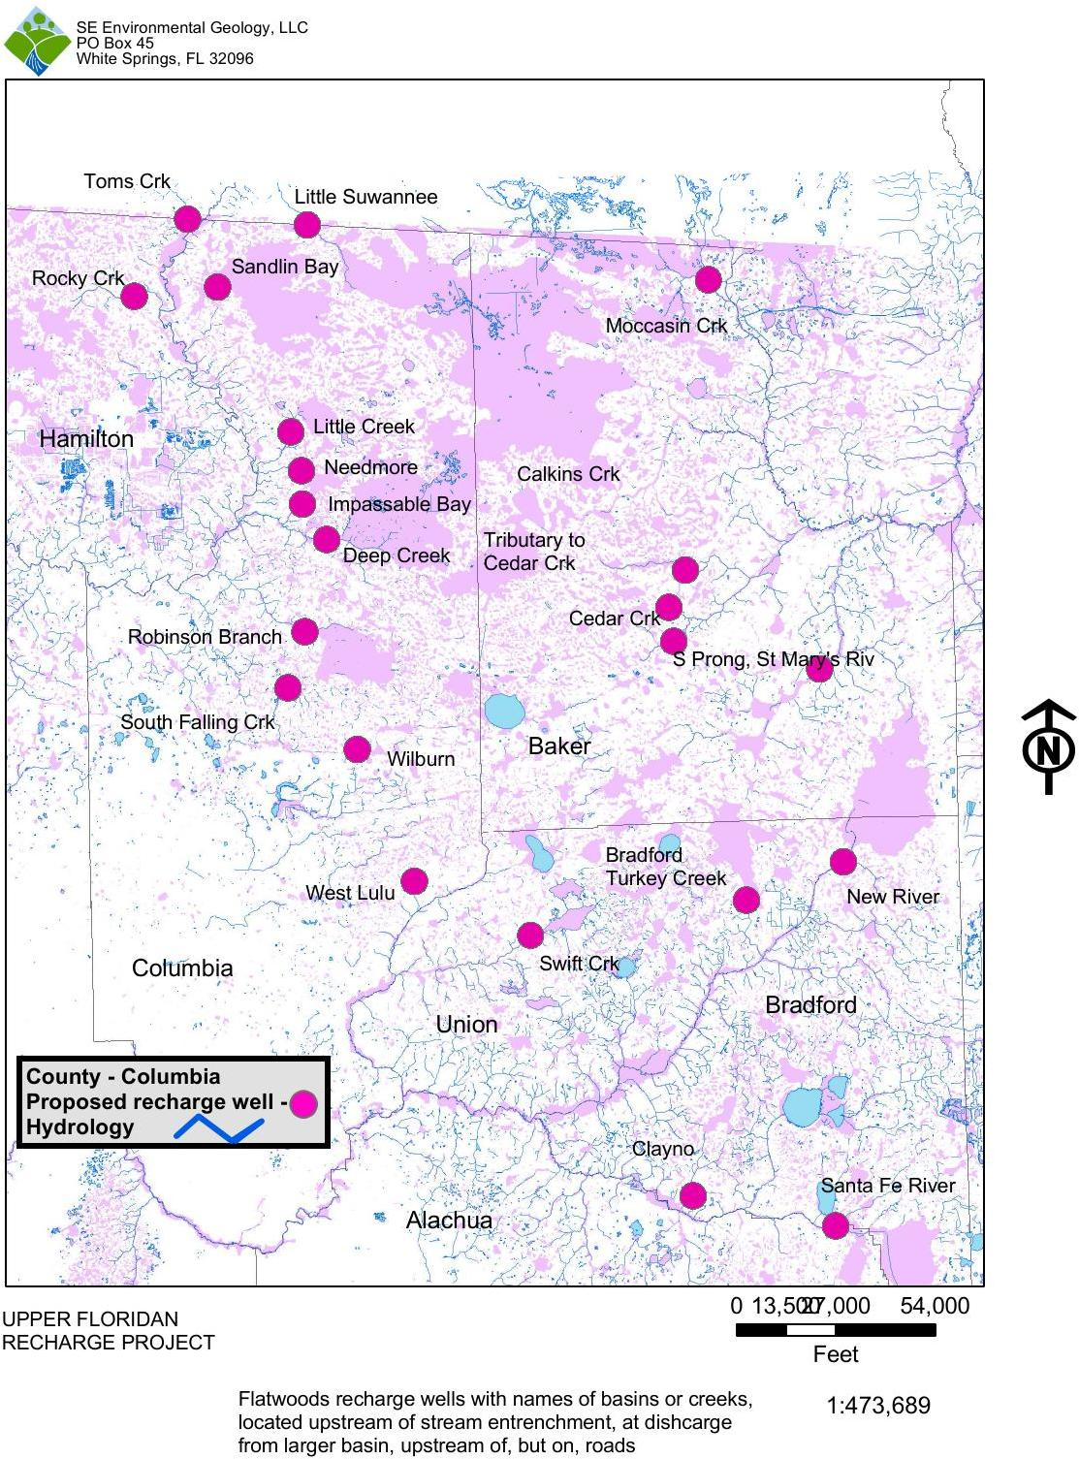
Wells below forestry ditches: Why not considered?
Dennis J. Price, P.G. proposed in 2016
They’re at overflow of wetlands below such ditches
Similar to WFNF wetlands
How can treated wastewater be cleaner than rainwater?

Slide 31
If Jacksonville’s wastewater is treated so well it can be piped into the Suwannee River Basin,
How about instead pipe that water into Jacksonville’s drinking water?
If people don’t want to drink it, how about use it for golf courses, datacenters, and other industrial uses in their own basin?

Slide 32
Desalination
SRWMD Board member for Upper Suwannee River Basin Larry Sessions: 2025-07-05:
the water need is mostly on the coast
and desalination is cheaper,
at least to flush toilets and wash cars.
Reduce JAX water use: eliminate effects on Suwannee Basin
Usual objection: desalination is expensive
Why can Texas, Arizona, and California do it?
For drinking water, not just grey water?
If they can, why not Florida?

Slide 33
Desalination plants elsewhere
TX: Harbor Island Seawater Desalination Facility; 2025; “up to 100 million gallons of drinking water per day for use by residents on the Gulf coast of Texas.”
AZ: Arizona water board approves desalination plants in California, Mexico; “trading that new water for Colorado River allocations currently used by those states or Mexico.” ? mgd
CA: These are just examples.
Doheny Ocean Desalination Project; “This new, locally managed water supply will fortify our resilience against future droughts and adapt to the challenges posed by a changing climate and emergencies.” 2025; 15 mgd
Diablo Canyon nuclear power plant (NPP) desalination plant; since 2015; 1.5 mgd
Poseidon Resources Corp. Claude “Bud” Lewis desalination plant, Carlsbad, CA; since 2015; 50 mgd
City of Santa Barbara’s Charles E. Meyer desalination plant; restarted 2015; 6.7 mgd
Monterey Peninsula desalination plant; 2025; ? mgd
Rejected: Huntington Beach desalination plant; 2022

Slide 34
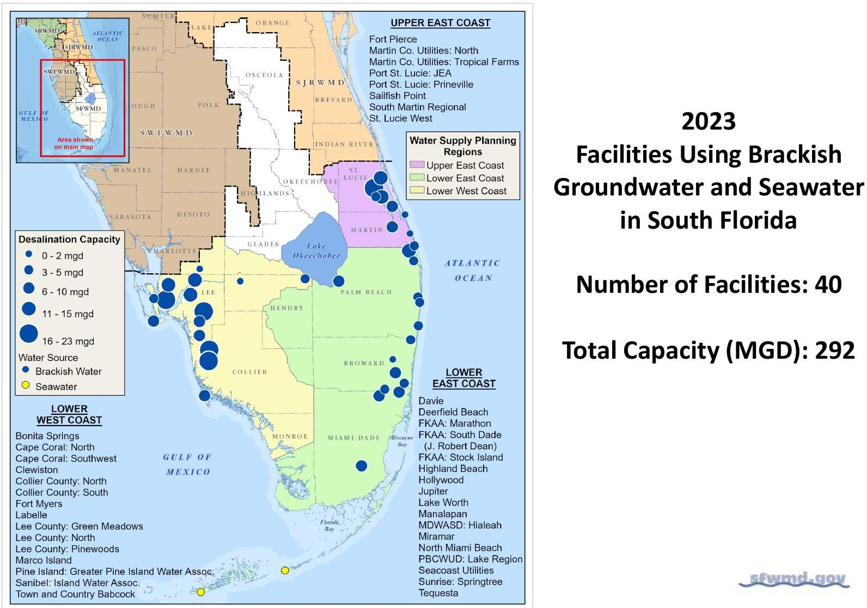
Actually, Florida already desalinates
Tampa Bay Seawater Desalination Plant; 2007; 25 mgd
Kermit H. Lewin Stock Island Reverse Osmosis Facility (Key West); May 2025; 4 mgd
SFWMD numerous facilities, 2023 total capacity 292 mgd

Slide 35
Desalination could eliminate Jacksonville’s water withdrawals
WFNF:
Only 40 mgd
More than a dozen years to build
Exports JAX water withdrawal problem to Suwannee Basin
In the form of treated wastewater
Huge engineering project prone to failures
Desalination:
Could be many distributed desalination plants
Why not all 120 mgd for JEA Drinking Water Service Areas?

Slide 36
SRWMD and SJRWMD reasons for rejecting desalination
https://wwals.net/?p=69648
High capital and operation and maintenance cost, partly due to the treatment process itself, and partly due to the high cost of brine disposal,
Desalination costs have dropped and should continue over the dozen-year timeframe of WFNF.
Managing brine disposal incurs significant technical and regulatory challenges,
Numerous desalination plants around the world manage brine, including 41 in the South Florida Water Management District (SFWMD) that produce about 292 million gallons a day of drinking water. JEA says JAX uses 120 mgd.

Slide 37
Continued: SRWMD and SJRWMD reasons for rejecting desalination
Replacement of all four participating utility groundwater pumping with desalinated seawater would not meet the full MFL requirements, and
Table ES.2 on page 7 says about desalination that, “Full MFL goals could be met based on current modeling and careful selection/design of recharge sites and methods”.
Ocean desalination does not address the requirements of Senate Bill 64 to put reclaimed water to beneficial use.
SB 64 is JEA’s problem, not a problem of the Suwannee River Basin.
It says treated wastewater can’t go into rivers starting 2032
With a loophole for what WFNF proposes to do.

Slide 38

https://wwals.net/issues/wfnf
See the above web page for:
Who to ask
Why Not WFNF
Upcoming meetings
Government bodies against
How to Comment
Background

Slide 39
Ways to make public comments
Social media does not count in the public record,
But can be good for getting people involved.
In person gets the attention of a decision-maker.
May not leave a record unless you’re at a recorded public meeting.
Telephone is often the most effective
Each call is usually logged (at least for statehouse or Congress)
and is taken to represent many more people who did not call
Written comments are best for anything complicated or detailed
Even if you telephone or speak, also send a written comment
Petitions get attention, but individual comments even more so

Slide 40
When you comment:
be polite
be brief
be specific
say something different from what everybody else said
tie it to your experience and to evidence
connect to the larger picture
All in a memorable way, of course.
Don’t worry if you can’t do all of the above.
Do what you can. Much better than doing nothing.

Slide 41
Framing
Don’t think of an elephant! Go ahead, try it.
Frame from your values, experience, and evidence, such as:
The problem is too much water withdrawal
The biggest withdrawer is the City of Jacksonville
Water bottlers use 1 mgd. JEA says JAX uses 120 mgd
South Florida does desalination, why not JAX?
How did such a big project happen without public input?
How can it proceed without much more information?

Slide 42
Examples of public comments:
Hailey Hall in Columbia County Observer about WFNF to the Columbia County Commission on February 21, 2026.
“What I heard in that video was not ‘this treatment plant can get the hormones out and get the PFAs out.’ I heard, ‘We’re researching it. We don’t know what it can even do yet.’ You don’t even know what you’re going to be putting into the ground.” —Hailey Hall, Suwannee County
https://www.columbiacountyobserver.com/master_files/County_News_2026/20260221-water-first-north-fl-makes-columbia-county-appeareance.html
WWALS written comments to that same Columbia County meeting.
https://wwals.net/?p=69442

Slide 43
More from the Columbia County Commission meeting:
"We were chosen because it's cheaper, easier, and shifts long-term risk from Jacksonville to us. They literally prioritized city growth over our health, our land, and our river systems." —Josie Gaskins, Columbia County
"Jacksonville just spent 925 million for a football team... if Jacksonville will do a 50 or $100 million [desalination] plant and let that aquifer fill itself back up, I think it'd be a better plan." — Robbie Hollingsworth, Columbia BOCC
"They have renamed the treated wastewater as 'reclaimed water' in order to make it more acceptable to those who are not paying close attention." — Carol Eckhert, Suwannee County

Slide 44
Still more from the Columbia County meeting:
"Did you know that JEA is under consent order right now?... That means that they're polluting the St. Johns River every day." — Merrilee Malwitz Jipson, Columbia County
“I have seen things like Occidental come in. I don't know where they were. When Occidental came in, they promised they would not take enough water out to ruin the springs and so forth. They did… I suggest tonight you call DeSantis, [and] your representative.” — Dee Paddock, Suwannee County
"We don't solve resource depletion by introducing new risks into the system. We solve it through responsible management, transparency, and protection of the resource itself." —Nathaniel Warner, Columbia County
“The people have spoken. We don’t want a big septic tank for Jacksonville’s waste.” —Kevin Parnell, Columbia BOCC

Slide 45
Comments from a Live Oak meeting
Jessica Wilkinson, WUFT, February 19, 2026,
Suwannee County residents unhappy with a $1 billion dollar water supply plan.
Area resident Ed Lee expressed his dissatisfaction with the plan approved by the Suwannee River Water Management District in November 2025 to address potable water issues. “Nobody has talked anything about money,” said Ed Lee. “Today you’re talking $1 billion. What the hell do you think it’s gonna cost with the time it gets there? It’ll be $15 billion.”
Suwannee Riverkeeper John S. Quarterman, “The entire area JEA serves uses 120 million gallons. Remember that Texas plant, one plant does 100 million gallons. There’s no reason it has to be all in one place,” said Quarterman. “It doesn’t have to take more than a dozen years to come online.”

Slide 46
More examples:
Dennis J. Price, P.G.’s op-ed in the Lake City Reporter, February 19, 2026.
https://wwals.net/?p=69519
Video of the February 2nd WWALS Webinar on WFNF, with appearances by Hailey Hall, Rick Lanese, Joe Squitieri, and others, after a presentation by Suwannee Riverkeeper John S. Quarterman.
https://wwals.net/?p=69378
A reference, How to Write Effective Public Comments, by the Environmental Data & Governance Initiative, Gehrke, G., & Paz, A. (2024).
https://envirodatagov.org/how-to-write-effective-public-comments/

Slide 47

Ask for explanations
or to stop the project:
Members of Congress & Statehouse
http://openstates.org/find_your_legislator/
SRWMD and SJRWMD Board
https://www.mysuwanneeriver.com/134/Current-Board-Members
https://www.sjrwmd.com/about/organization/directors/
County Commissioners and City Councils
https://www.fl-counties.com/2025-fac-directory/
Florida Counties Task Force about wastewater
https://wwals.net/?p=68081

Slide 48

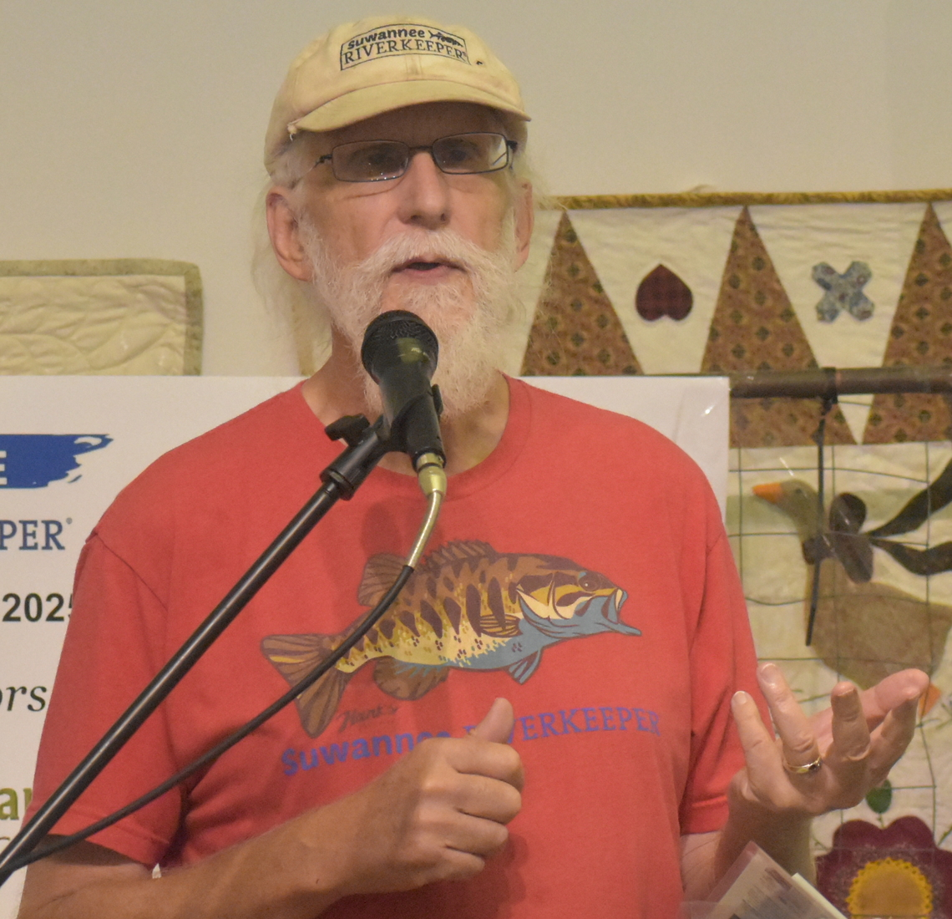

Contact:
John S. Quarterman, & Executive Director 229-242-0102 contact@suwanneeriverkeeper.org www.suwanneeriverkeeper.org,
WWALS Watershed Coalition, Inc. (WWALS) 850-290-2350 wwalswatershed@gmail.com www.wwals.net PO Box 88, Hahira, GA 31632
Notes:
https://wwals.net/donations/

